Slide 1
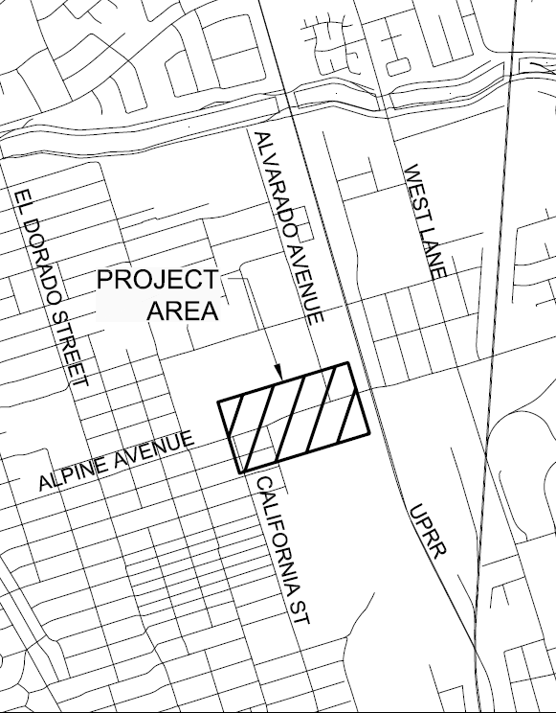

Alpine and Alvarado Avenue Conversion to 3-way Traffic Signal Project – CML-5008(193)
San Joaquin Valley Project Level Conformity Group Presentation
May 22, 2024

Slide 2
Project Overview
Project Description
Location and Other Background Information
Purpose and Need
Project Listing in the FTIP
Traffic Data and Summary
Project Schedule
Project-level Conformity Summary

Slide 3
Project Description
The City of Stockton proposes to install a traffic signal at the intersection of Alpine Avenue & Alvarado Avenue.
Additional Project features include:
Installation of new sidewalks and ADA curb ramps along Alvarado Avenue
Converting shared left-turn & right-turn lane into exclusive left & right-turn lanes on Alvarado Avenue
New eastbound left-turn pocket along Alpine Avenue
Encroachment permits and traffic detours will be required during project construction
Project consists of a No-Build and One-Build Scenario. The No-Build scenario assumes no changes will be made to existing features.
Alpine & Alvarado Project does not meet the criteria of an exempt project under 40 CFR 93.126 or 93.128

Slide 4
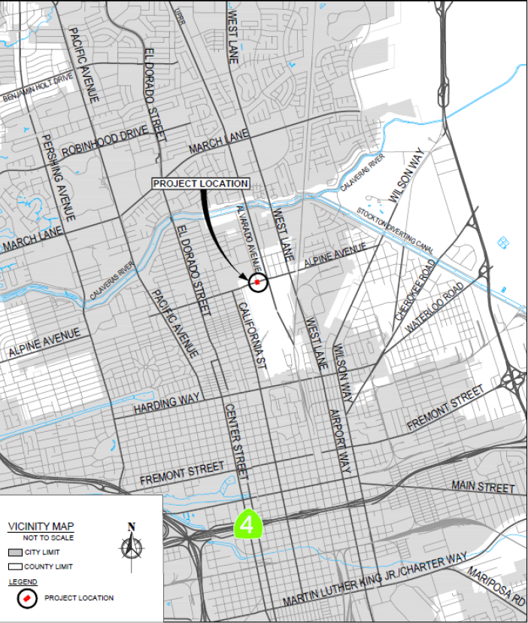
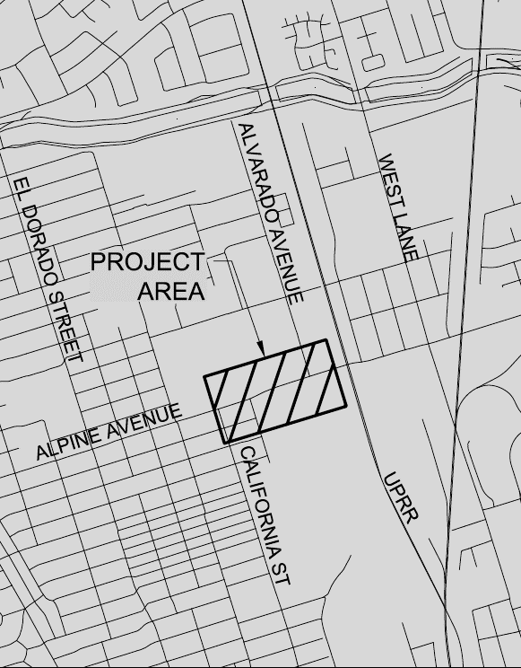
Project Location

Slide 5
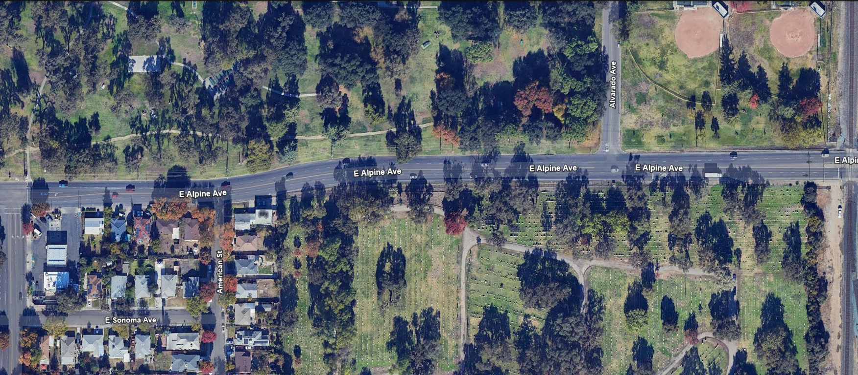
Project Location
Project Limits

Slide 6
Project Purpose and Need
The purpose of this project is to:
Provide congestion relief on Alpine Avenue
Improve traffic flow to meet existing and forecasted traffic demand
Reduce the number of collisions at the intersection
The project is needed because:
The existing lane configuration cannot meet existing or forecasted traffic demand
The current collision rate is significantly higher than the state average for similar facilities

Slide 7
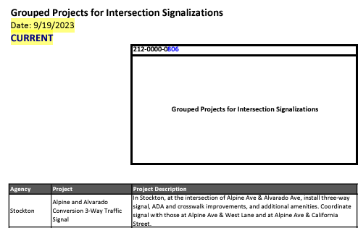
Project Listing in the TIP
The proposed project is listed in the SJCOG Federal Transportation Improvement Program (FTIP) 2023 amendment Number 22.
2023 FTIP / 2022 RTP received federal approval on 12/16/2022. Amendment #22 was adopted by SJCOG on 9/28/2023 and received FHWA approval on 10/13/2023.
The scope of the proposed project is consistent with the project description in the 2023 FTIP.
Project is funded by the FHWA’s Congestion Mitigation & Air Quality Improvement Program (CMAQ) and local funds.
https://www.sjcog.org/DocumentCenter/View/8835/SJCOG-2023-FTIP-Amend-22-IAC

Slide 8
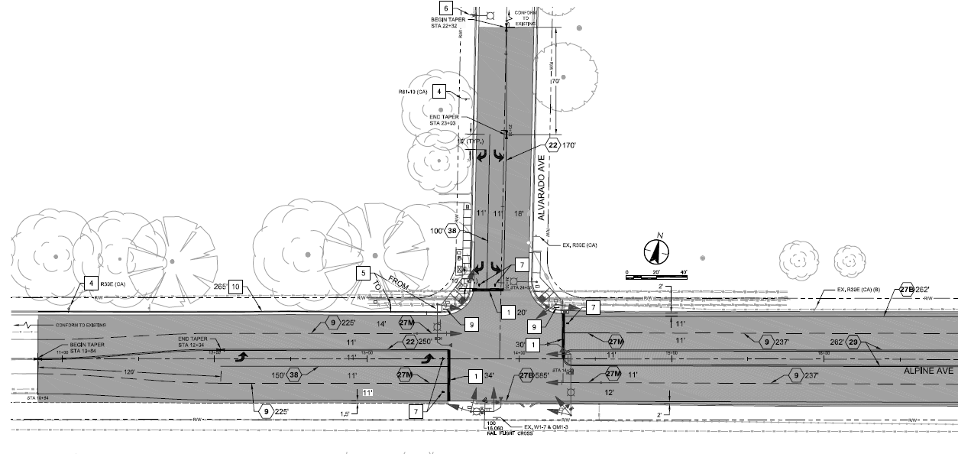
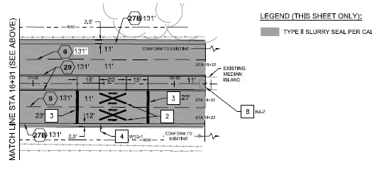
Build Scenario Project Feature

Slide 9
Traffic Data
Years Considered: Three different years are considered for assessing the traffic data.
Existing (2023)
Opening (2025)
Analysis year (2045) [The design year of the project is selected as the analysis year.]
Truck Percentages will be 2% of total AADT
Existing Year (2023): Traffic data consisting of Average Daily Traffic (ADT) and trucks ADT for the existing 2023 year is shown below:
Roadway | Build Scenario | AADT | Truck AADT (2%)
Alpine Avenue | 2023 Existing | 21,036 | 420

Slide 10
Traffic Data
Opening Year (2025): Traffic data consisting of Average Daily Traffic (ADT) and trucks ADT for the Opening 2025 year is shown below:
Roadway | Build Scenario | AADT | Truck AADT (2%)
Alpine Avenue | 2025 Opening – No Build | 21,456 | 429
 | 2025 Opening - Build | 21,456 | 429
Alvarado Avenue | 2025 Opening – No Build | 1,195 | 24
 | 2025 Opening - Build | 1,195 | 24

Slide 11
Traffic Data
Analysis (Design) Year (2045): Traffic data consisting of Average Daily Traffic (ADT) and trucks ADT for the Opening 2045 year is shown below:
Roadway | Build Scenario | AADT | Truck AADT (2%)
Alpine Avenue | 2045 Design – No Build | 25,243 | 505
 | 2045 Design - Build | 25,243 | 505
Alvarado Avenue | 2045 Design – No Build | 1,434 | 29
 | 2045 Design - Build | 1,434 | 29

Slide 12
Traffic Data – Level of Service (LOS) and Delay Analysis
Alternative | AM Peak |  | PM Peak
 | Delay (sec) | LOS | Delay (sec) | LOS
2023 Existing Condition | 264.0 | F | 161.5 | F
2025 Opening Year – No Build Condition | 264.0 | F | 161.5 | F
2025 Opening Year – Build Condition | 8.0 | A | 8.0 | A
2045 Design Year – No Build Condition | 1025 | F | 892 | F
2045 Design Year – Build Condition | 10.5 | B | 10.2 | B

Slide 13
Summary of Traffic Findings
The project would not result in significantly increased daily truck trips for build conditions
Truck percentages will remain at 2% of the total AADT under Existing, Opening Build & No Build, and Design Build & No Build conditions.
Additionally, project improves the level of service at the project intersection
Existing Year (2023): The intersection operates at LOS F during the AM and PM Peak hours
Opening Year (2025): The intersection will improve from LOS F to LOS A between the No Build and Build scenarios during both the AM and PM Peak hours
Analysis/Design Year (2045): The intersection will improve from LOS F to LOS B between the No Build and Build scenarios during both the AM and PM Peak hours

Slide 14
Project Schedule
 | Approximate Dates
Target Environmental Documents Approval | Spring 2024
Target Project Design Completion | Spring 2024
Award Contract | Summer 2024
Approve Contract | Fall 2024
Construction Begins | 2024
Construction Ends | 2025

Slide 15
Project-level Conformity Conclusion
Project does not meet the criteria for a POAQC as defined in the final rule by 40 CFR 93.123(b)(1). The project is listed as one of the non-exempt project examples that are not a local air quality concern under 40 CFR 93.123(b)(1)(i) and (ii) stated as
“Intersection channelization projects, traffic circles or roundabouts, intersection signalization projects at individual intersections, and interchange reconfiguration projects that are designed to improve traffic flow and vehicle speeds, and do not involve any increases in idling. Thus, they would be expected to have a neutral or positive influence on PM emissions”

Slide 16
Project-level Conformity Conclusion
Additional reasons the project is not a POAQC:
The Proposed project (Build Alternative) is expected to improve traffic flow and reduce vehicle miles traveled in the study area with the implementation of a new traffic signal, and eastbound left-turn pocket along Alpine Avenue, and converting the shared left and right-turn to an exclusive left and right-turn.
The Proposed project (Build Alternative) is expected to lessen delay times and car/truck idling at the intersection, reducing the amount of harmful emissions.
The proposed project will not result in an increase in traffic/truck volumes (AADT) over the life of the project.

Slide 17
Questions?
Contact Information
Ivan Reynoso
Associate Engineer
Ivan.Reynoso@stocktonca.gov

