Slide 1
SJCOG Alternative Fuels Vision Plan
Final Workshop
September 27th, 2023
Dave tokarski Sarah Sweet
Project manager Deputy Project Manager
dmt@dksassociates.com SLS@dksassociates.com

Slide 2



PROJECT CONSULTANT TEAM

Slide 3
AGENDA
Project Goals Review
Existing Conditions
Analysis and Findings
Recommendations and Funding
Final Plan
Q&A
Notes:
Sarah

Slide 4
Project goals
Assess existing ZEV infrastructure including unincorporated rural areas between cities
Identify key challenges, gaps and barriers to travel for motorists, regional transit and goods movement
Identify where equity issues currently exist with access to alternative fueling stations
Notes:
Sarah

Slide 5
Project goals continued…
Ensure equitable infrastructure improvements and investments accessible to all users including underserved populations
Recommend infrastructure improvements, investments, policies, and implementation strategies to promote ZEV infrastructure adoption
Identify programs and incentives as well as provide potential funding opportunities
Notes:
Sarah

Slide 6
Existing conditions
Notes:
Image of report, get link of where they can find report

Slide 7
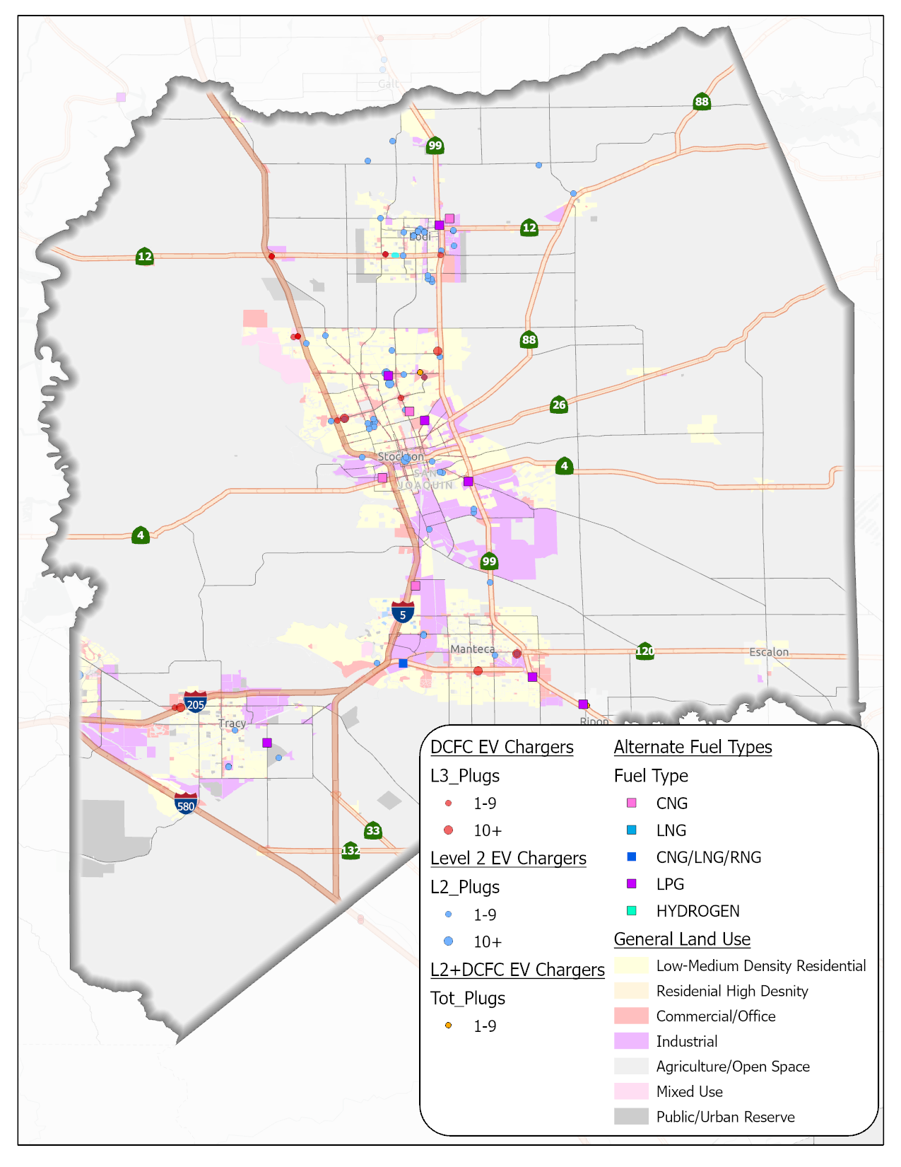
Existing Conditions
Summary of fuel types
Key corridors
Inventory of existing chargers and alternative fueling stations by type
Proximity to state highways, disadvantaged communities and multi-unit dwellings
Available online at: https://www.sjcog.org/DocumentCenter/View/7615/1-SJCOG-Existing-Conditions_12_1_22_Final
Notes:
Dave
https://www.sjcog.org/DocumentCenter/View/7615/1-SJCOG-Existing-Conditions_12_1_22_Final

Slide 8
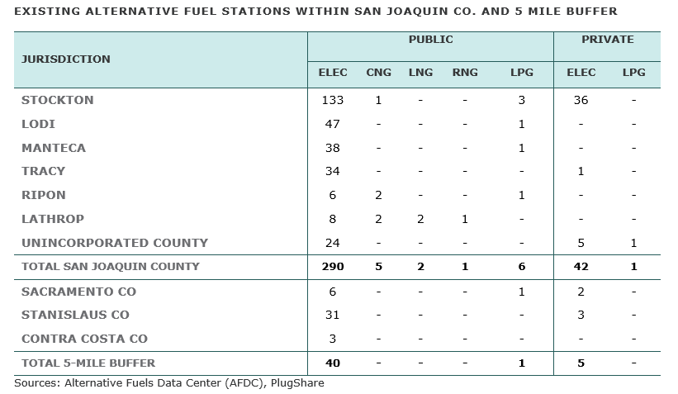
Existing Conditions
Notes:
Dave
https://www.sjcog.org/DocumentCenter/View/7615/1-SJCOG-Existing-Conditions_12_1_22_Final

Slide 9
Existing Conditions
Notes:
Dave
https://www.sjcog.org/DocumentCenter/View/7615/1-SJCOG-Existing-Conditions_12_1_22_Final

Slide 10
Analysis & Findings

Slide 11
EV Growth Scenarios
Notes:
Dave

Slide 12
Forecasted Charger Needs
Notes:
Dave

Slide 13
Forecasted Charger Needs
Notes:
Dave

Slide 14
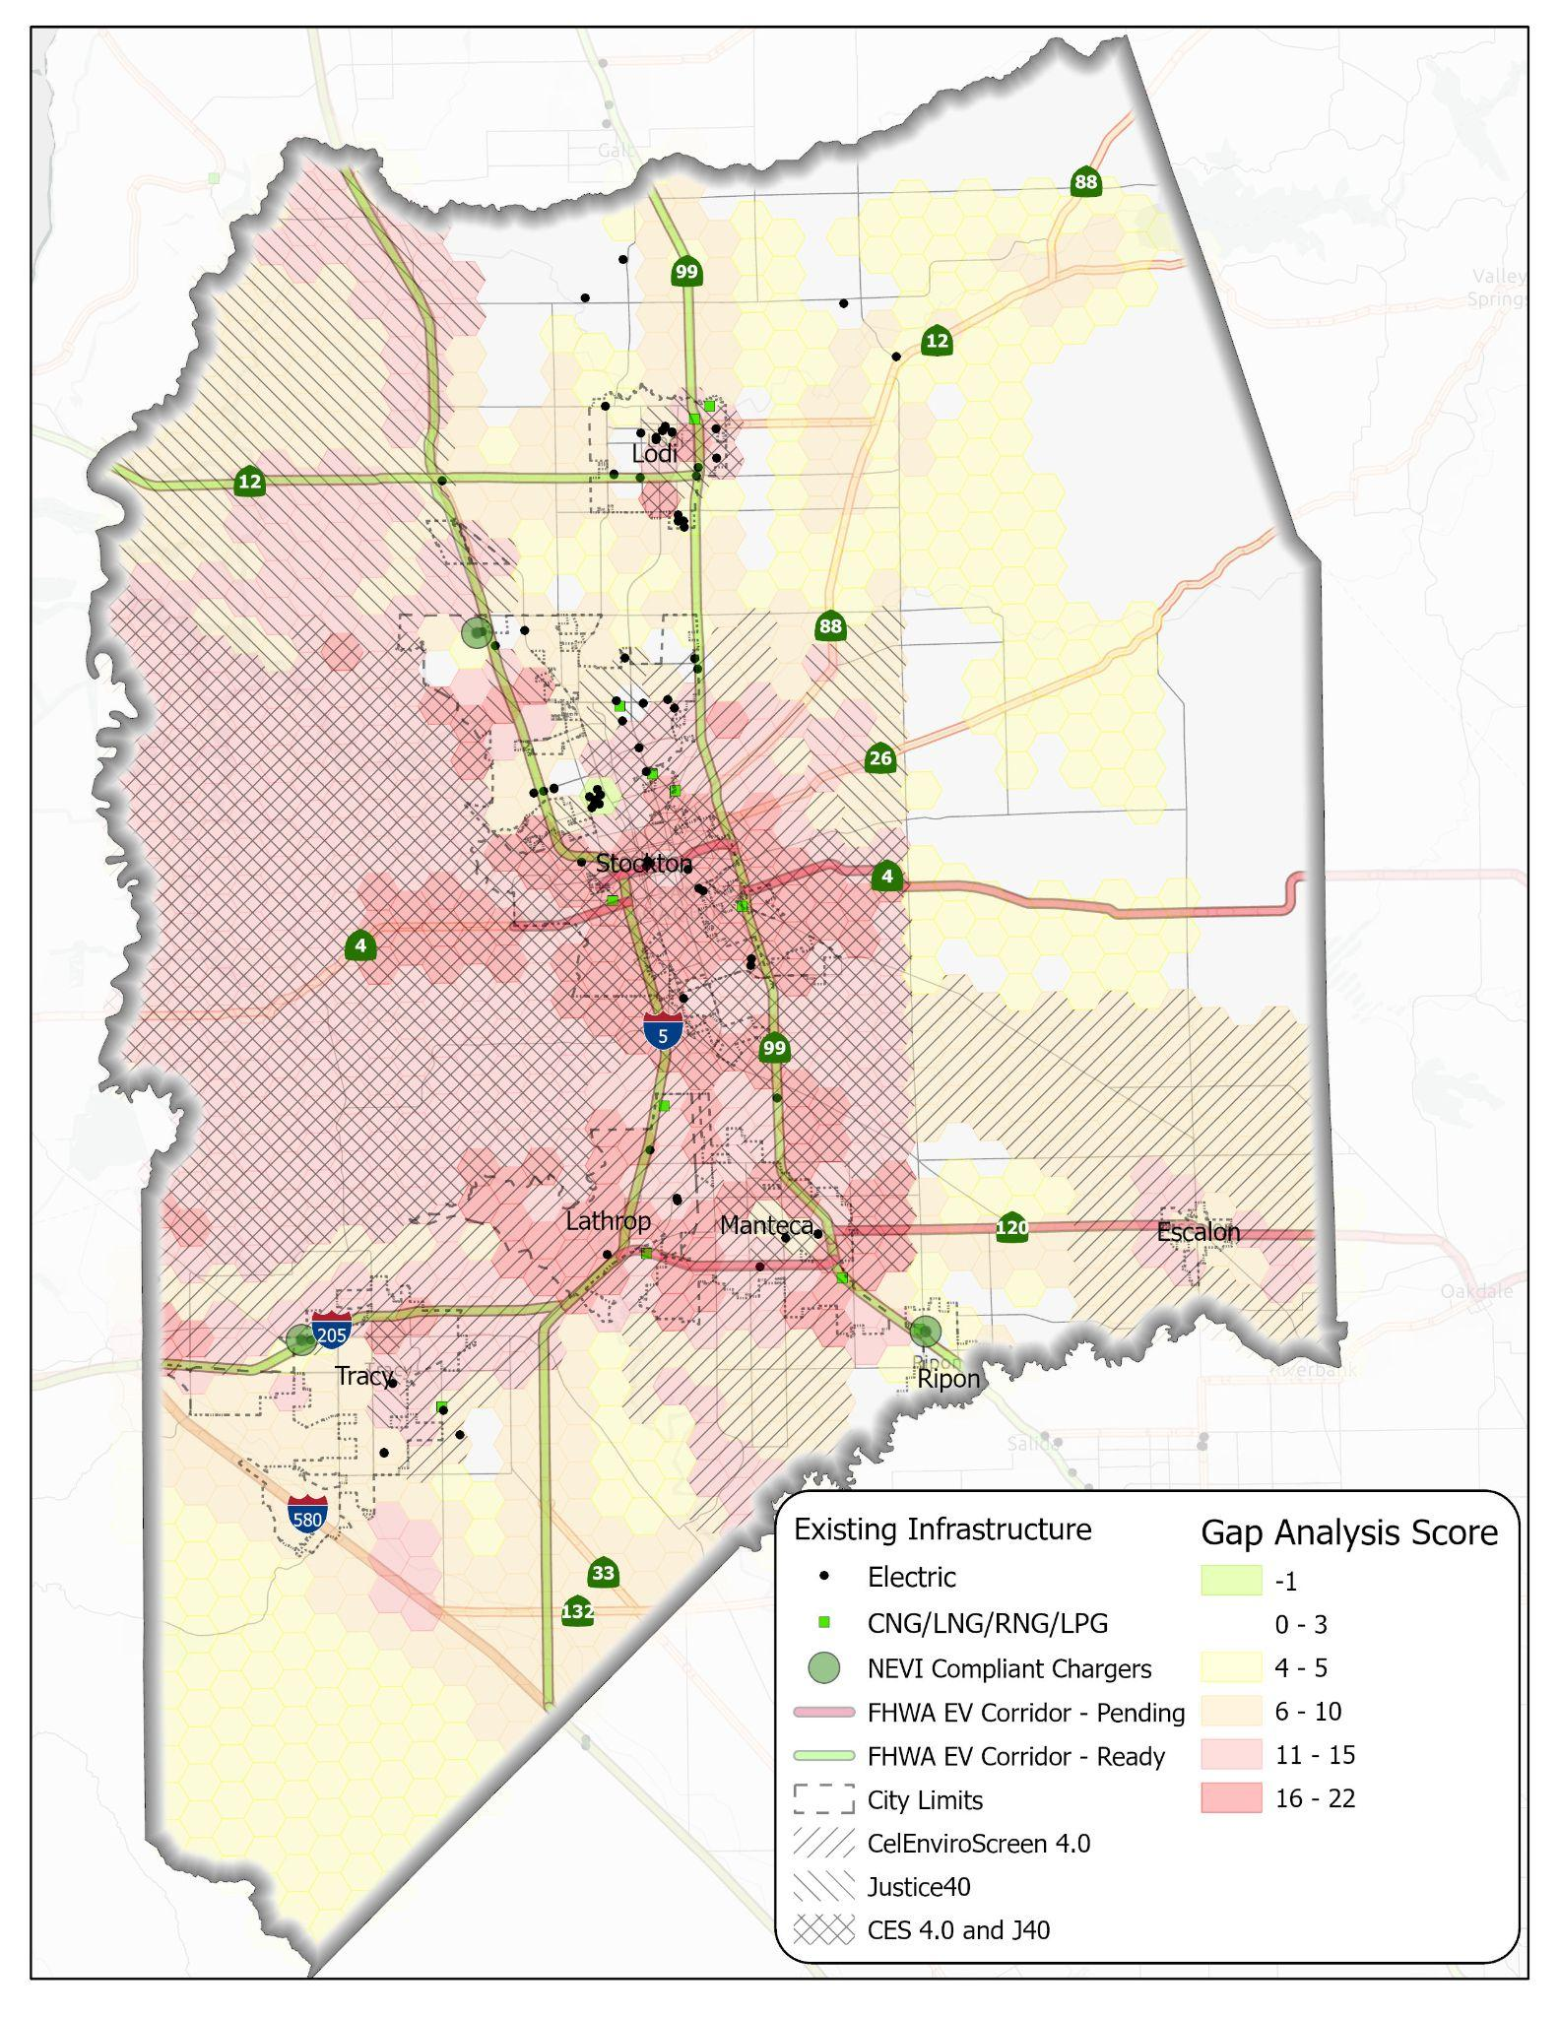
GAP Analysis
Included Input from:
Existing conditions report
Community Feedback
Data Including:
Driver demographics
Dwell time
Volume of visits
Distance of trip
Duration of trip
Light, medium, and heavy-duty
Location of amenities
Notes:
Dave

Slide 15
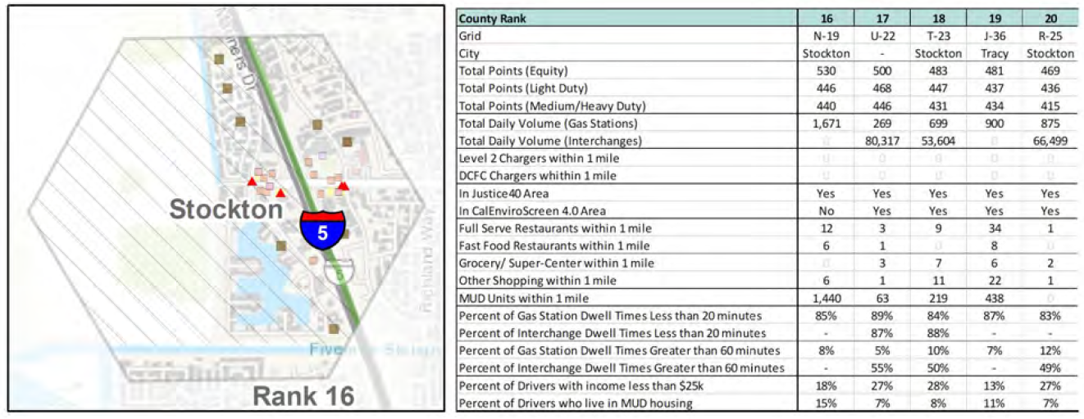

Ranking Analysis
Notes:
Dave

Slide 16
Recommendations and Funding

Slide 17
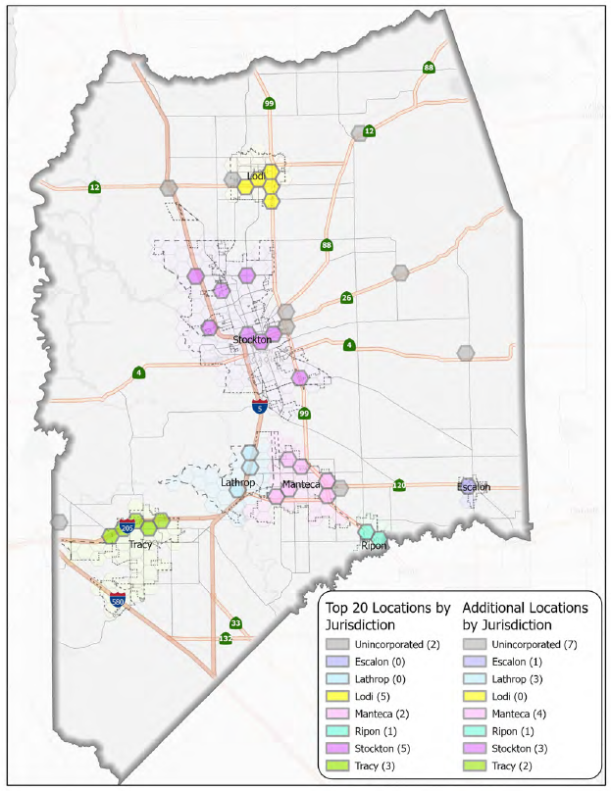
Recommended Locations
Identified a total of 39 area recommended locations:
30 locations across incorporated cities
9 locations in unincorporated San Joaquin County
Alternative Fuels Corridor Recommendations:
State Route 12
State Route 26
State Route 88
Notes:
Dave: Map of top 20 locations

Slide 18
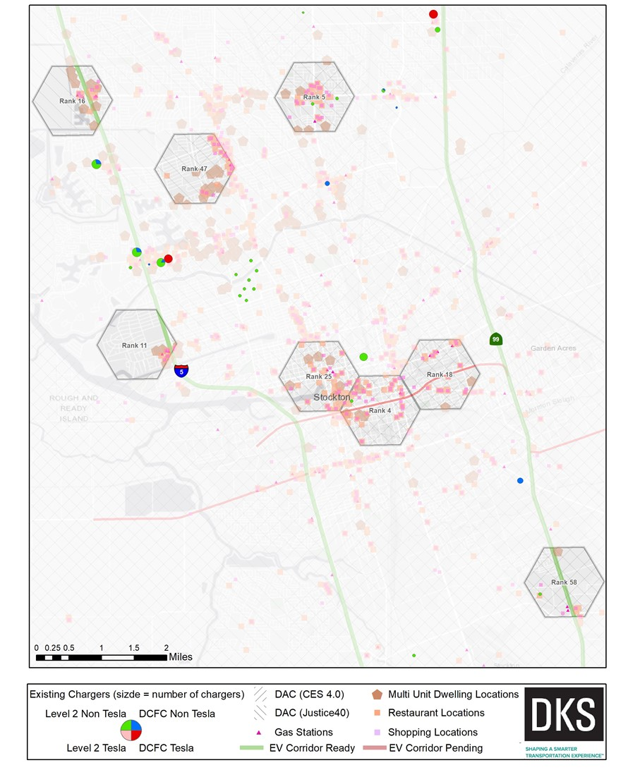
Recommended Locations
City of Stockton
Adjacent to State Route 4 and South Stanislaus Street (Rank 4)
Adjacent to East Hammer Lane and West Lane (Rank 5)
West of Interstate 5 and West Alpine Avenue/ Country Club Road (Rank 11)
West of Interstate 5 and Hammer Lane (Rank 16)
Adjacent to State Route 4 and South Filbert Street (Rank 18)
Downtown Stockton near Park Street and Center Street (Rank 25)
Adjacent to West Benjamin Holt Drive and North Pershing Avenue (Rank 47)
Adjacent to State Route 99 and Arch Road interchange (Rank 58)
Notes:
Dave: Map of top 20 locations

Slide 19
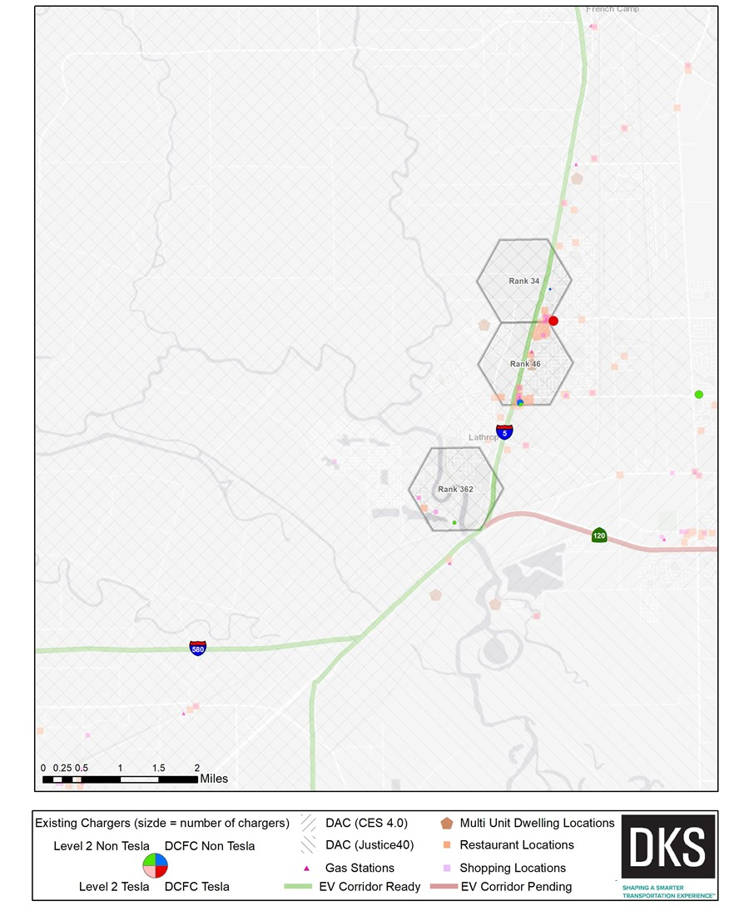
Recommended Locations
City of Lathrop
Adjacent to Interstate 5 and West Lathrop Road (Rank 34)
Adjacent to Interstate 5 and East Louise Avenue (Rank 46)
Adjacent to interchange of Interstate 5 and State Route 120 (Rank 362)
Notes:
Dave: Map of top 20 locations

Slide 20
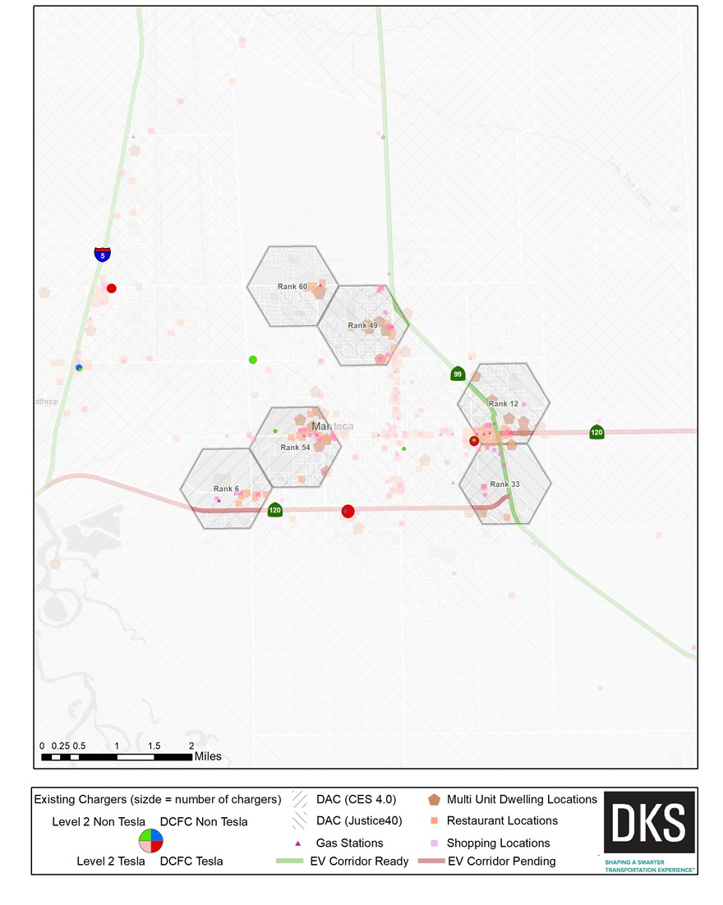
Recommended Locations
City of Manteca
Adjacent to State Route 120 and South Airport Way (Rank 6)
Adjacent to State Route 99 and East Yosemite Avenue (Rank 12)
Adjacent to interchange of State Route 99 and State Route 120 (Rank 33)
Southwest of State Route 99 and Lathrop Road (Rank 49)
Near West Yosemite Avenue between South Airport Way and South Union Road (Rank 54)
Near Lathrop Road between South Airport Way and South Union Road (Rank 60)
Notes:
Dave: Map of top 20 locations

Slide 21
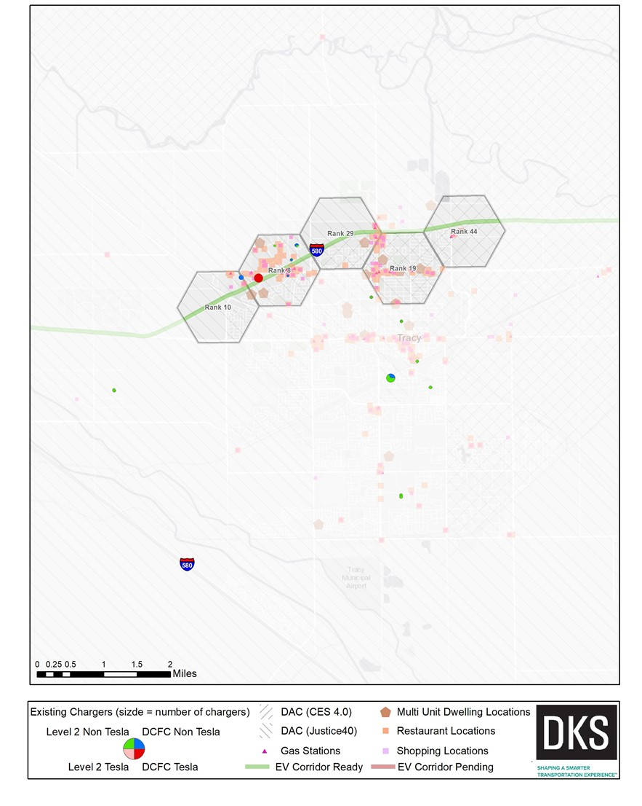
Recommended Locations
City of Tracy
Adjacent to Interstate 205 and West Grant Line Road (Rank 8)
Adjacent to Interstate 205 and Byron Road (Rank 10)
East of West Grant Line Road and North Tracy Boulevard (Rank 19)
Adjacent to Interstate 205 between North Tracy Blvd and West Grant Line Rd (Rank 29)
Adjacent to Interstate 205 and North MacArthur Drive (Rank 44)
Notes:
Dave: Map of top 20 locations

Slide 22
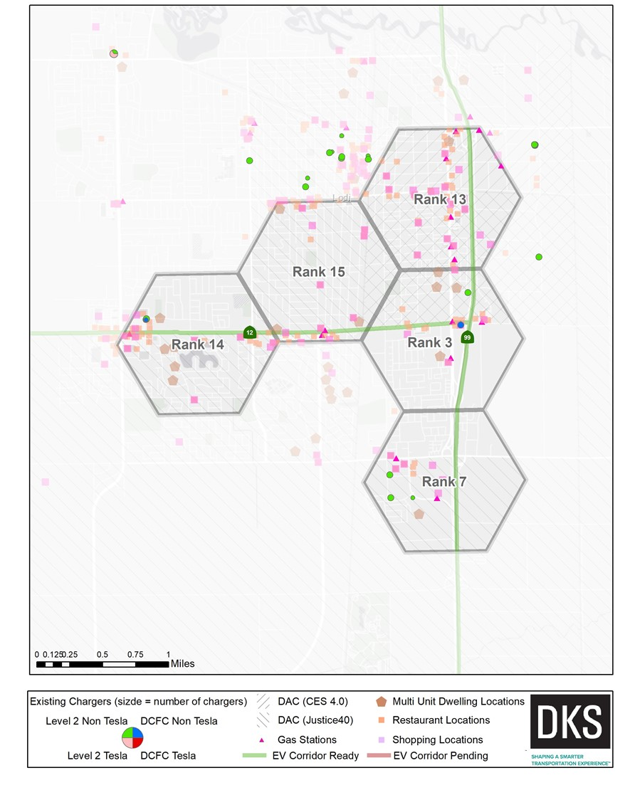
Recommended Locations
City of Lodi
Adjacent to State Route 99 and East Kettleman Lane (Rank 3)
Adjacent to State Route 99 and East Harney Lane (Rank 7)
Southwest of State Route 99 and East Victor Road (Rank 13)
Adjacent to West Kettleman Lane between South Lower Sacramento Road and South Ham Lane (Rank 14)
North of West Kettleman Lane between South Ham Lane and South Stockton Street (Rank 15)
Notes:
Dave: Map of top 20 locations

Slide 23
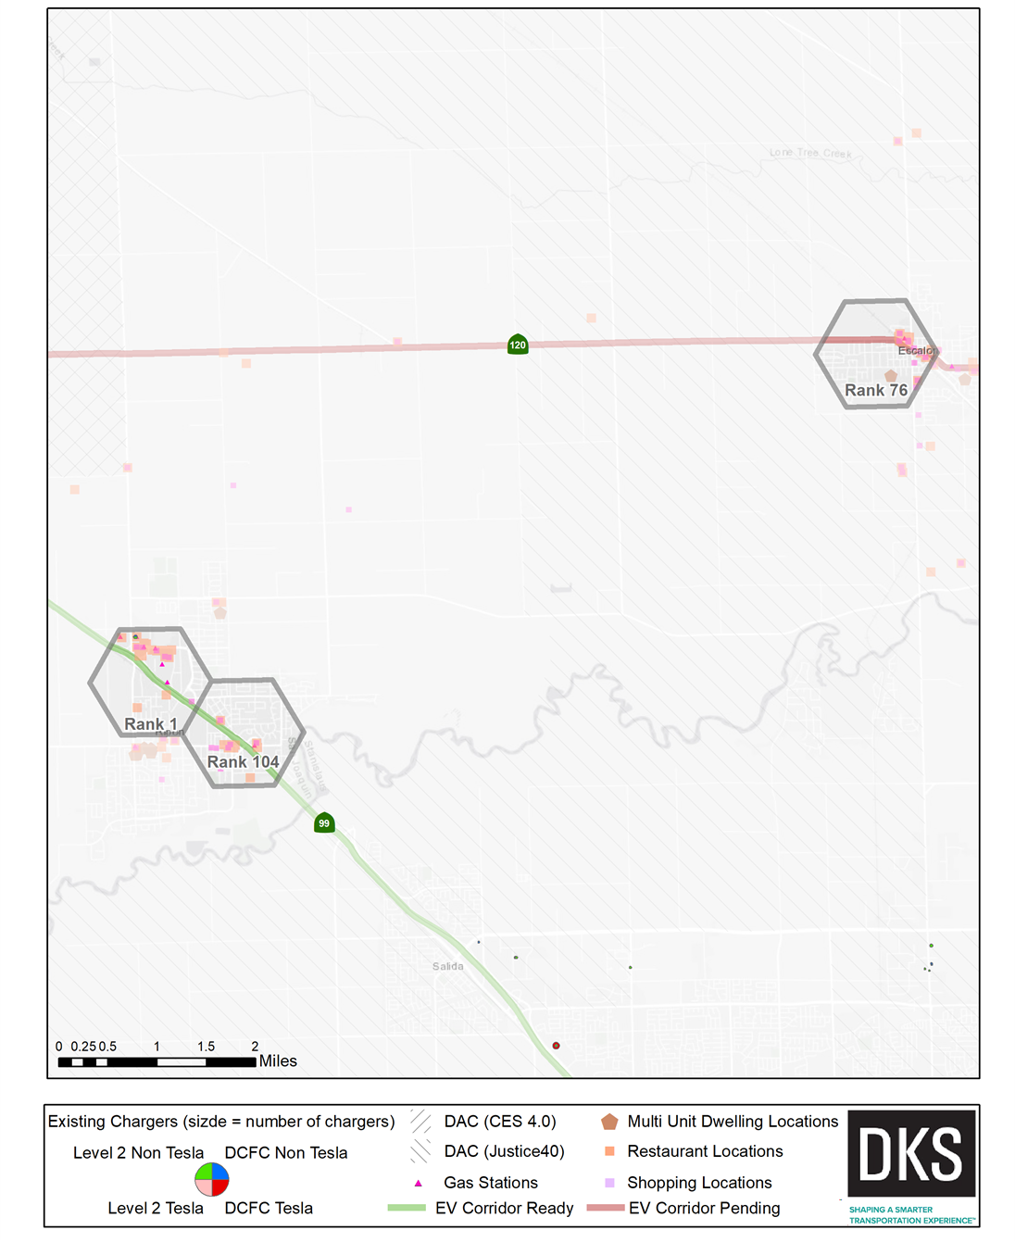
Recommended Locations
Cities of Escalon and Manteca
Adjacent to State Route 120 in downtown Escalon (Rank 76)
State Route 99 at Jack Tone Road (Rank 1)
State Route 99 at Main Street (Rank 104)
Notes:
Dave: Map of top 20 locations

Slide 24
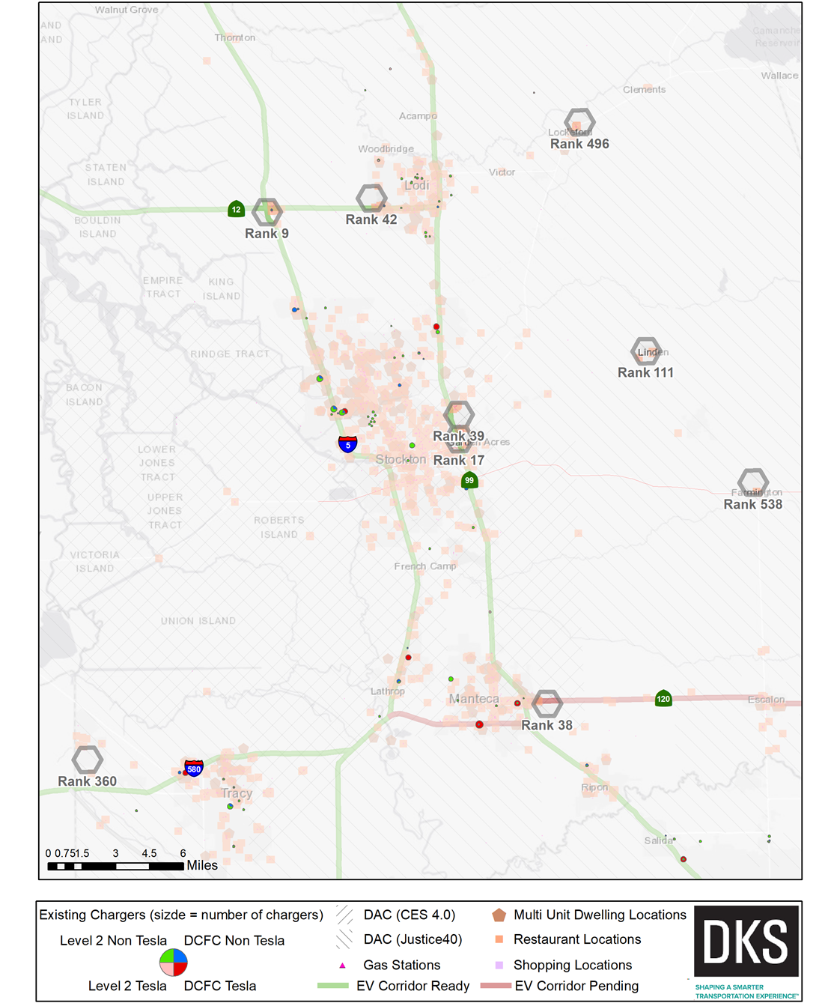
Recommended Locations
Unincorporated San Joaquin County
Flag City Interchange Interstate 5 at State Route 12 (Rank 9)
Garden Acres Adjacent to State Route 99 and State Route 4 (Rank 17)
Adjacent to State Route 120 and Austin Road (Rank 38)
Northeast of State Route 99 and Waterloo Road (Rank 39)
Adjacent to State Route 12 and Lower Sacramento Road (Rank 42)
Unincorporated Town of Linden (Rank 111)
Unincorporated Town of Mountain House (Rank 360)
Unincorporated Town of Lockeford (Rank 496)
Unincorporated Town of Farmington (Rank 538)
Notes:
Dave: Map of top 20 locations

Slide 25
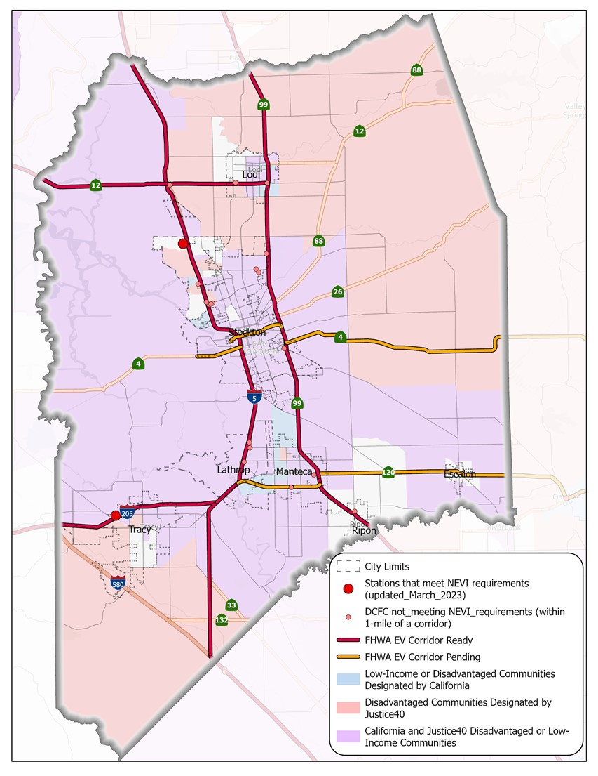





Recommended Corridors
Proposed Alternative Fuels Corridor Recommendations:
State Route 12
State Route 26
State Route 88
Notes:
Dave: Map of top 20 locations

Slide 26
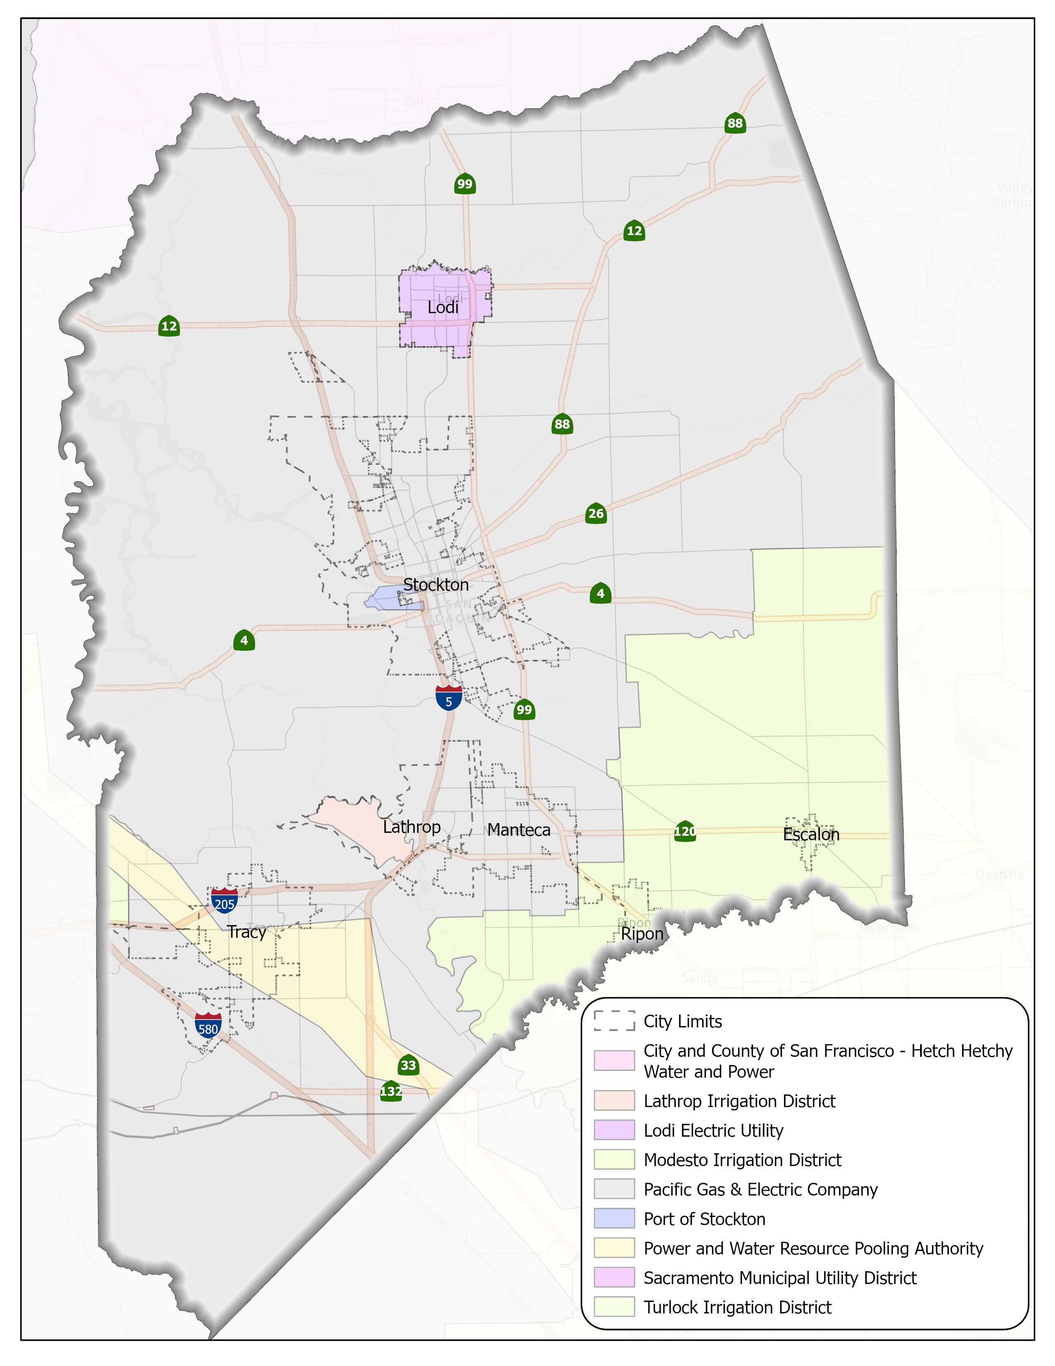
INFRASTRUCTURE DEPLOYMENT
Installation guidelines
Best practices
Suggestions for location, layout, operational and data connectivity
Addressing grid constraints and resiliency
Notes:
Sarah: Map of utilities

Slide 27
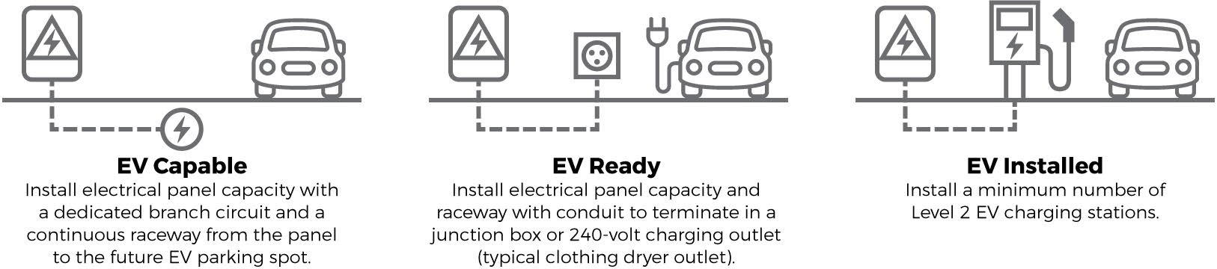
INFRASTRUCTURE DEPLOYMENT
Degrees of EVSE Support
Notes:
Sarah: Discussion of EV Capable,Ready,Installed

Slide 28
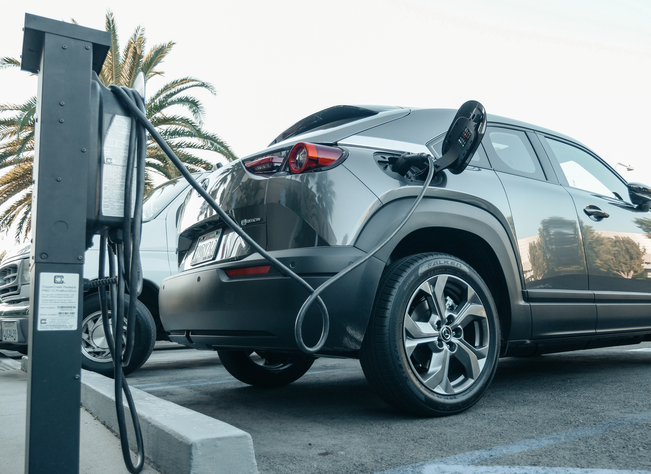
General Actions
Cooperative committee
Community engagement
Develop and track progress toward goals
Home and workplace charging
Supporting fleets
Notes:
Sarah

Slide 29
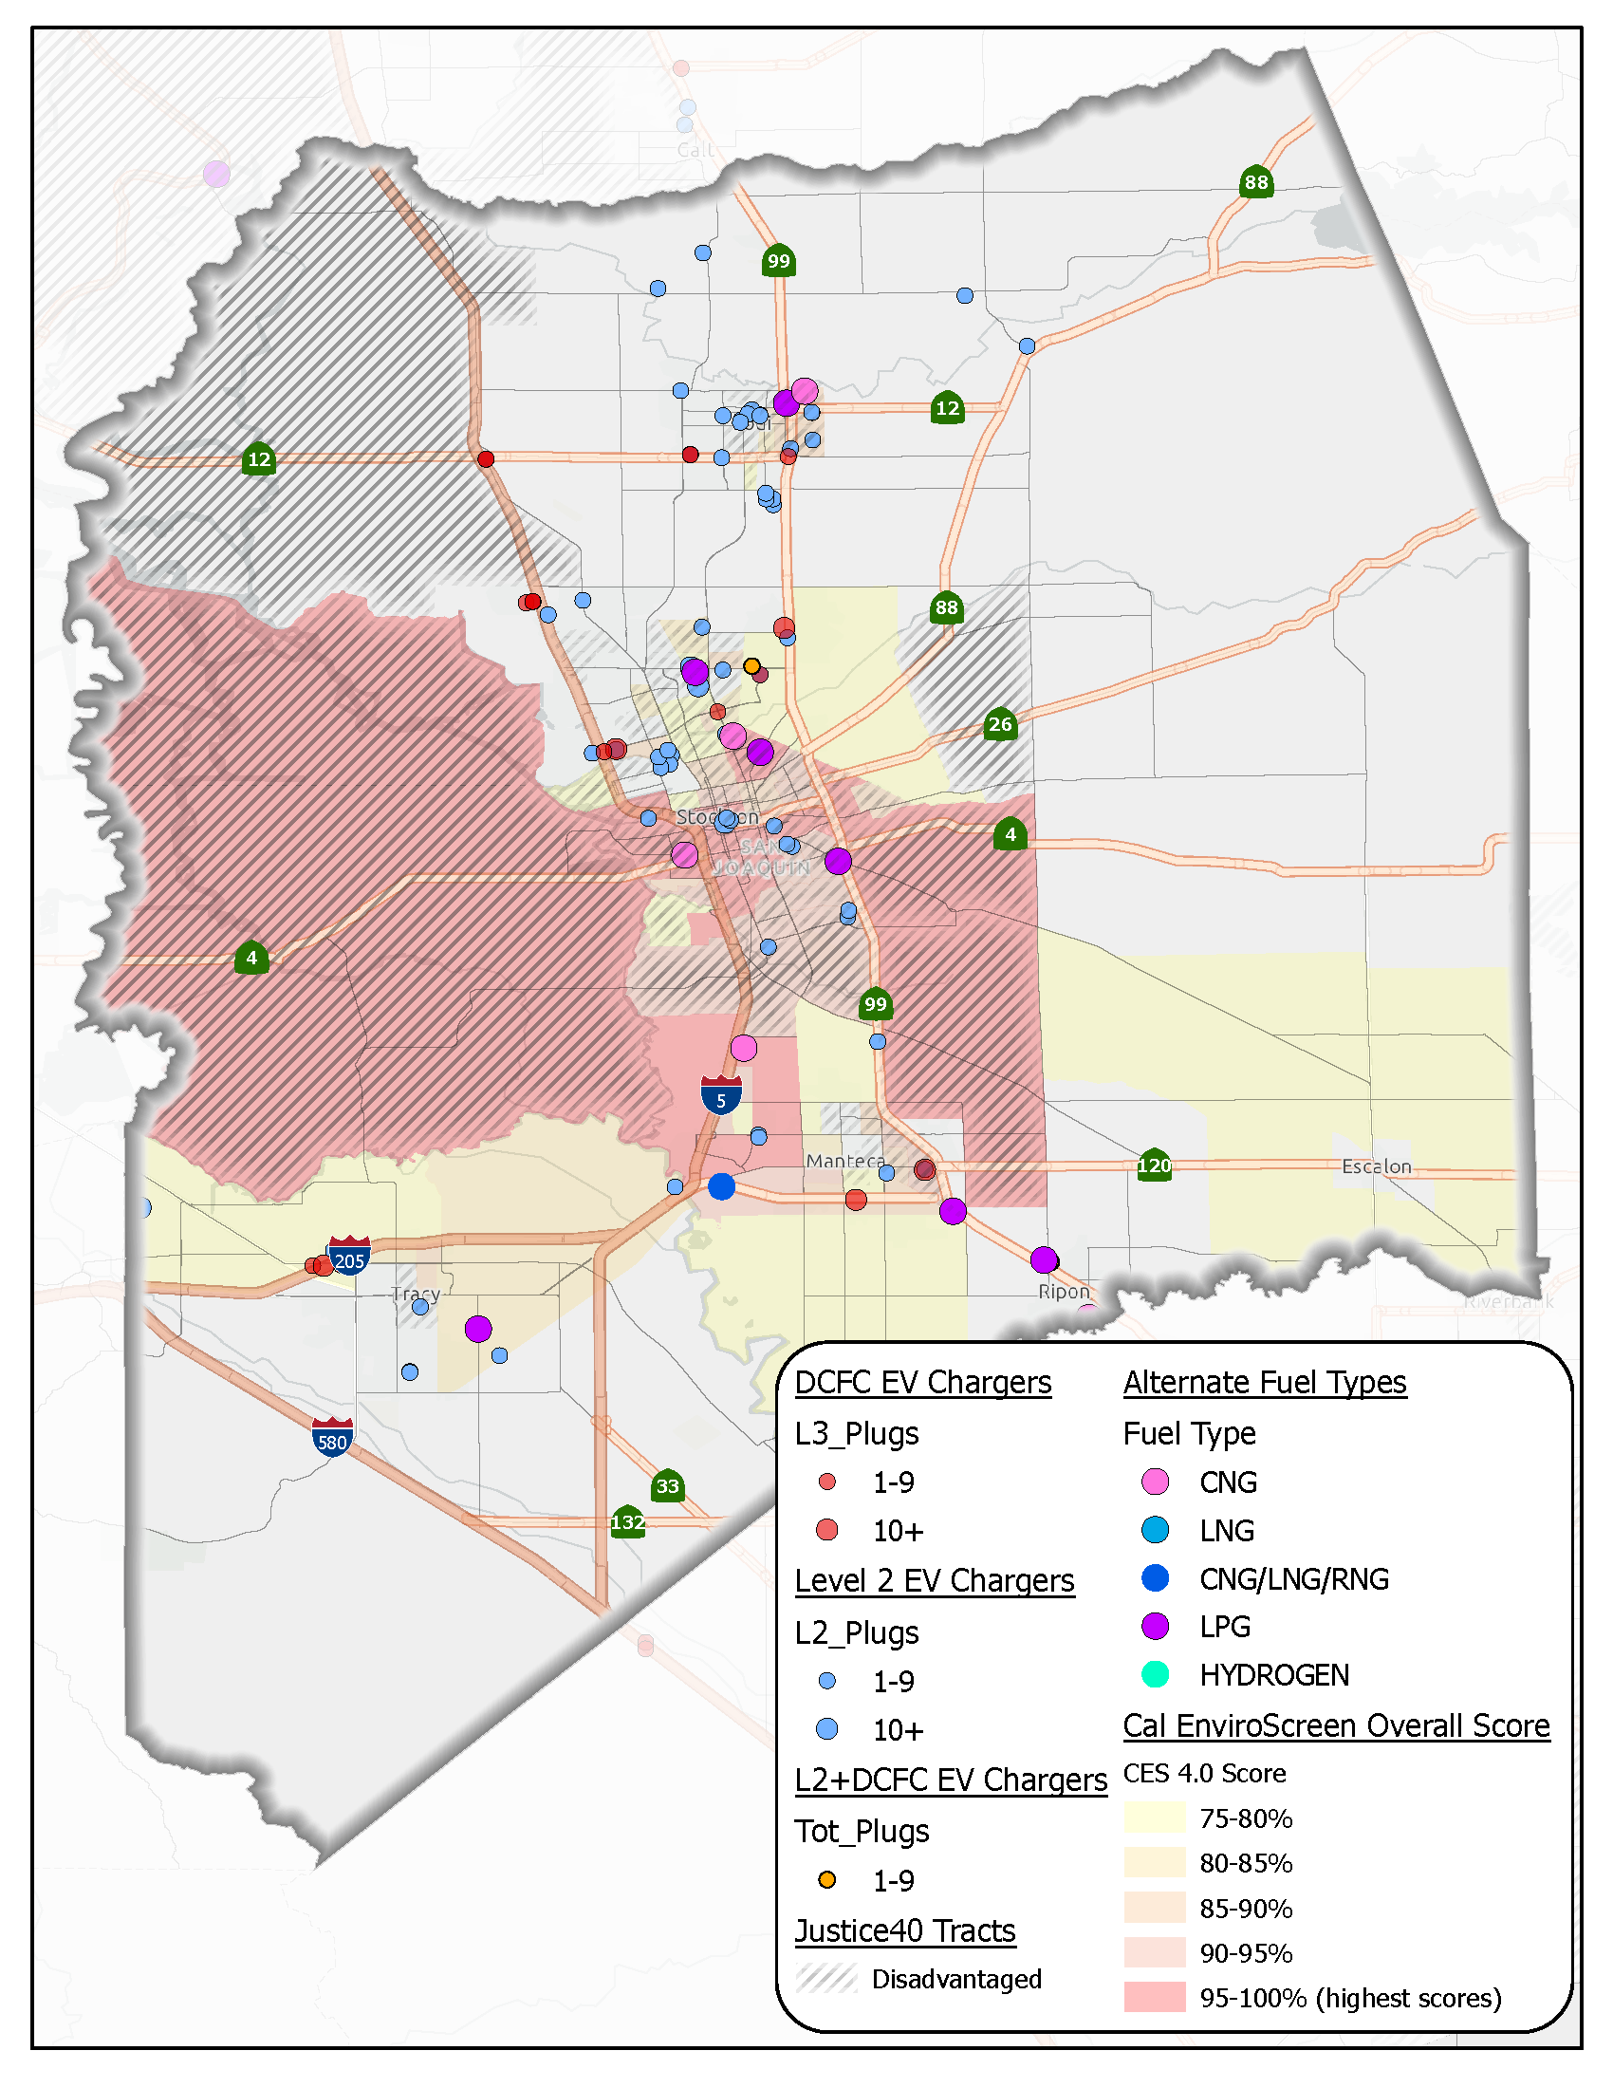
Addressing Equity
Making EVs more affordable and accessible
Increase access to charging Address range anxiety in rural areas
Tailored community engagement
Support transit
Charging for Multiunit Dwellings
Notes:
Sarah

Slide 30

Funding
Federal
NEVI
USDOT Grants
EPA Grants
State
California Energy Commission
California Air Resource Board
Local
Pacific Gas and Electric
San Joaquin Valley Air Pollution Control District
Notes:
Sarah

Slide 31
Next steps
Identify Grant Funding to Pursue
Addressing Barriers
Prioritizing Recommendations and implementing programs
Notes:
Isaiah

Slide 32
Questions or Comments?

Slide 33
THANK YOU
Dave tokarski Sarah Sweet
Project manager Deputy Project Manager
dmt@dksassociates.com SLS@dksassociates.com

