Slide 1
Transforming the Housing Funding Landscape
April 25, 2023

Slide 2
Panelists
Jim Harnish (moderator), Principal/Owner, Mintier Harnish
Peter Ragsdale, Executive Director, Housing Authority County of San Joaquin
Tom Collishaw, President/CEO, Self-Help Enterprises
Kate Owens, Principal, HR&A Advisors, Inc.
2
Notes:
Tom Collishaw is the CEO of Self-Help Enterprises, a nonprofit housing and community development organization serving the San Joaquin Valley since 1965. Self-Help Enterprises has developed or preserved over 16,000 housing units, including both single family homes and rental apartments, all for low-income households. They also provide housing and infrastructure services to cities, counties and small districts throughout the valley.
Kate Owens is a principal at HR&A Advisors, a real estate and economic development consulting firm. Her work focuses on supporting the development and implementation of affordable housing programs across the country. Her projects have ranged from developing Amazon’s housing equity fund that provided $2 billion in gap financing to designing the California Dream for All shared appreciation program that CalHFA recently launched. She is currently working with SJCOG to explore the viability of launching a regional housing trust fund in San Joaquin County.

Slide 3
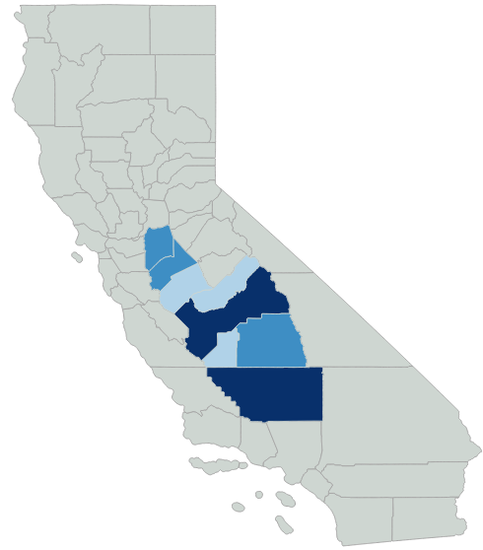

Affordable Housing Unit Gap
San Joaquin Valley
(2022)
San Joaquin Valley has a 123,000 unit affordable housing gap, which is roughly 10% of the State’s gap
AMI is roughly $77,000 in most of the Valley
Construction costs are still high in the Valley resulting in large project level financing gaps
19,100
15,500
6,700
3,800
36,500
11,317
4,100
25,550
Source: California Housing Partnership, Data Dashboard
Notes:
LA County has 500,000 unit gap for comparison

Slide 4
Annual State & Federal LIHTC Allocations
San Joaquin Valley
San Joaquin Valley makes up 11% of the population of the state but has received a declining share of allocations
Average annual county level allocations are less than $6 million
Fresno County received the most allocations, $186 million or 41% of allocations
Source: California State Treasurer, CTCAC Project Mapping, https://www.treasurer.ca.gov/ctcac/projects.asp

Slide 5
HCD Super NOFA Applications & Results (2022)
in San Joaquin Valley
San Joaquin Valley received $81 million or 12% of the awards from HCD’s 2022 super NOFA
20 projects applied for 7% of the total requests
Projects in Kern County and San Joaquin County did not receive awards
Bakersfield Affordable Housing Trust Fund, in Kern County, applied for and received funding from HCD’s local housing trust fund NOFAs
Sponsor | County | Units | Total Award | Requested Amount
Visionary Home Builders | Merced | 108 | $ 25,122,245 | $ 25,122,245
Self-Help Enterprises | Fresno | 123 |  | $ 18,987,489
Ethos Project Holdings | San Joaquin | 100 |  | $ 17,864,000
Visionary Home Builders | Merced | 80 | $ 17,376,324 | $ 17,376,324
Central Cali. Housing Corp | Fresno | 59 |  | $ 16,051,656
Housing Authority of Kern County | Kern | 59 |  | $ 13,975,000
Self-Help Enterprises | Tulare | 80 | $ 13,768,709 | $ 13,768,709
Self-Help Enterprises | Fresno | 64 | $ 12,687,573 | $ 12,687,573
CRDC | San Joaquin | 46 |  | $ 11,400,000
Christian Church Homes | Tulare | 70 |  | $ 10,829,296
Housing Authority of San Joaquin | San Joaquin | 51 |  | $ 10,072,021
Self-Help Enterprises | Fresno | 98 |  | $ 9,127,029
Pacific Southwest CDC | Fresno | 80 |  | $ 9,082,348
Housing Authority of Fresno | Fresno | 60 |  | $ 8,273,353
Housing Authority of Fresno | Fresno | 63 |  | $ 7,135,490
Self-Help Enterprises | Merced | 66 |  | $ 6,654,505
The Richman Group of California | Merced | 156 | $ 6,478,807 | $ 6,478,807
Housing Authority of Kern County | Kern | 551 |  | $ 5,970,000
Pacific Southwest CDC | Merced | 60 |  | $ 5,854,187
Self-Help Enterprises | Madera | 70 | $ 3,552,000 | $ 3,552,000
Self-Help Enterprises | Tulare | 57 | $ 2,413,494 | $ 2,413,494
Total in SJ Valley |  | 2101 | $ 81,399,152 | $ 232,675,526
Total in State |  |  | $ 699,734,836 | $ 3,544,089,564
Share of Award/Requests |  |  | 12% | 7%
Source: HCD, Multifamily Super NOFA Round 1 – Final Point Score and Awardee List
Notes:
Kern asked for $5M and only got $2.1M and then $5M and got $3M – so I guess they got their $5M over two years of applications – but there were others that got their full asks several years in a row

Slide 6
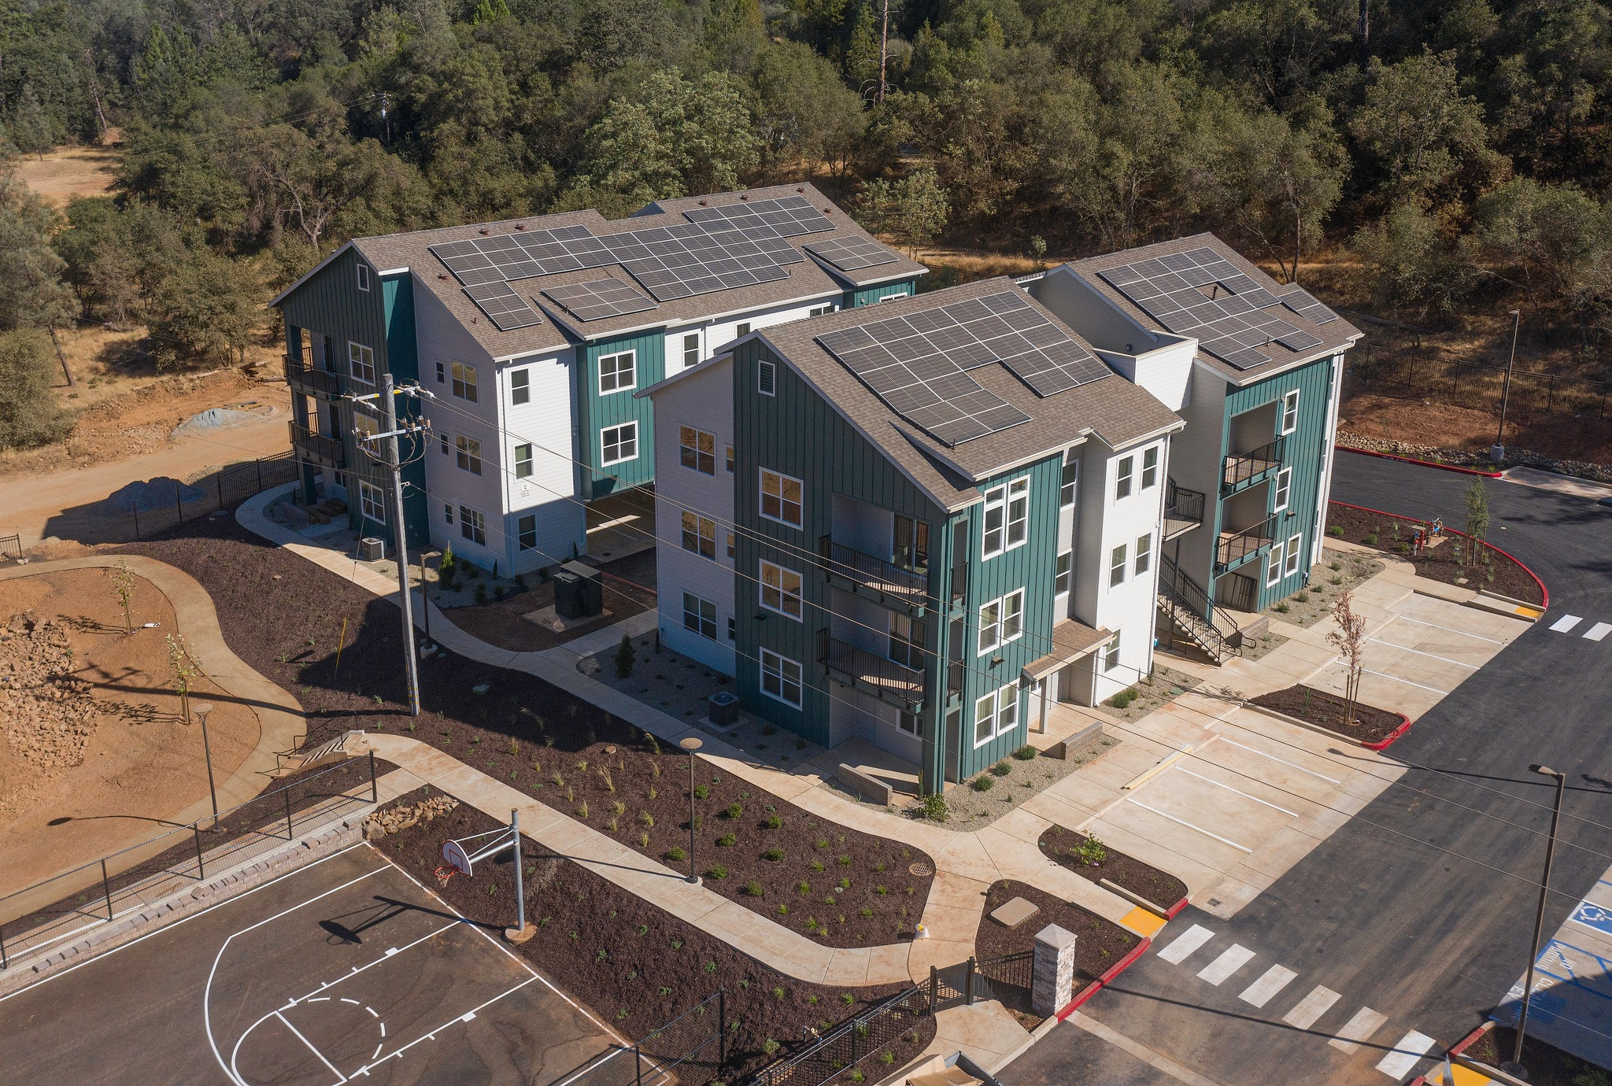
Creekside Terrace, Mariposa, Self-Help Enterprises
6

Slide 7
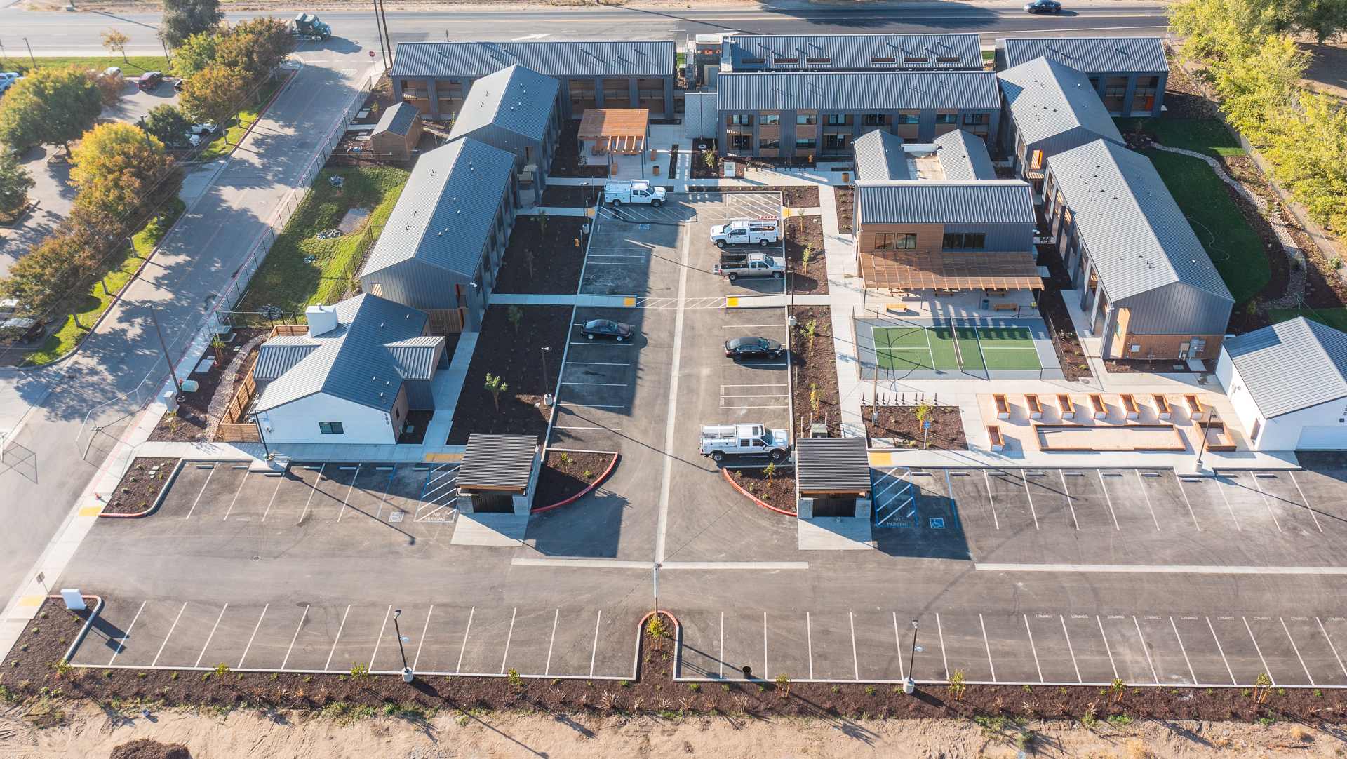
Victory Gardens, French Camp, HACSJ
7

Slide 8
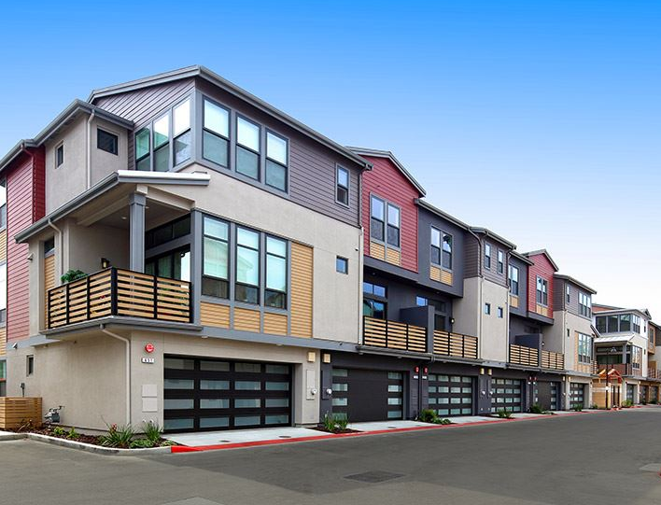
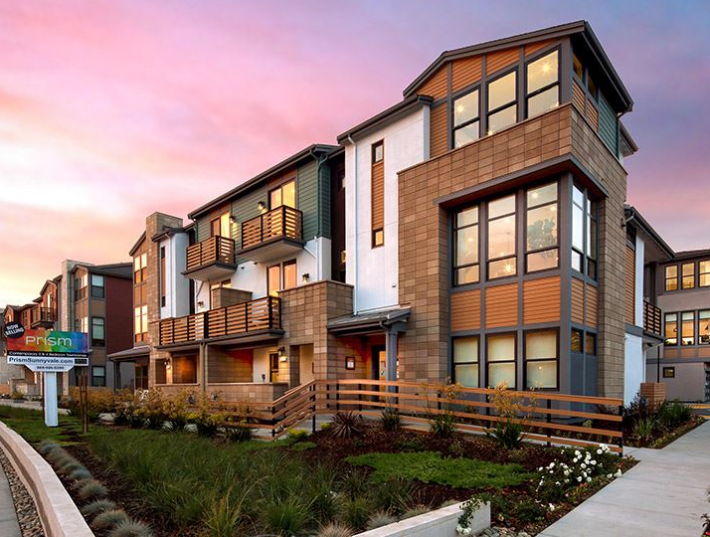
Housing In San Joaquin Valley: Challenges & Opportunities
Findings
Recommendations
Lack of funding was identified as the number one Valley housing issue by opinion survey respondents and stakeholders
Key Valley funding problems:
  Chaotic State funding system
  Complex funding systems
  Funding increasingly tied to increased density
  Limited funding for areas with less-developed transportation systems
  Difficulty of assembling financing packages without bonding, housing trust funds, or philanthropic “soft” money
Consider inclusionary zoning to generate affordable housing as well as in-lieu fees to leverage grants or other funding sources activities.
• Form local trust funds
• Coordinate and seek funding from local philanthropic foundations.
• Leverage local funds to obtain best returns on State and Federal funding requests.
• Partner with other jurisdictions on projects of mutual interest (e.g., a city/county partnership to support farmworker or homeless housing project).

