Slide 1

A Brief Overview of the NSJV April 26, 2023 SJV Policy Conference Session: “The CERF Experiment: Building Economic Prosperity Through Research & Partnerships”
Thomas Pogue, Executive Director
Center for Business and Policy Research
Eberhardt School of Business
University of the Pacific
https://www.pacificcbpr.org/

Slide 2
NSJV Population
Total population in 2022 => 1.6 million
San Joaquin 48%, Stanislaus 34%, Merced 18%

Slide 3
NSJV Communities Pollution Burden

Slide 4
NSJV Gross Regional Product
As of 2021, total GRP in the NSJV was $64.7 billion

Slide 5
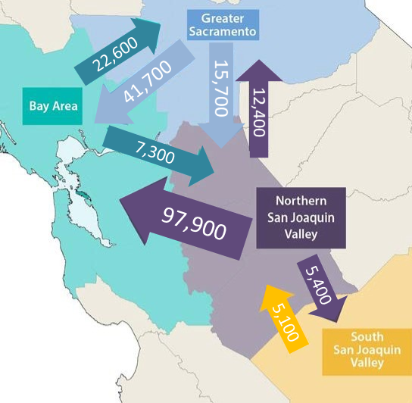
Commute Patterns
2019 Commute Flows Across the NCMR

Slide 6
Net Adjustment for Residence as % of Total Wages & Salaries

Slide 7
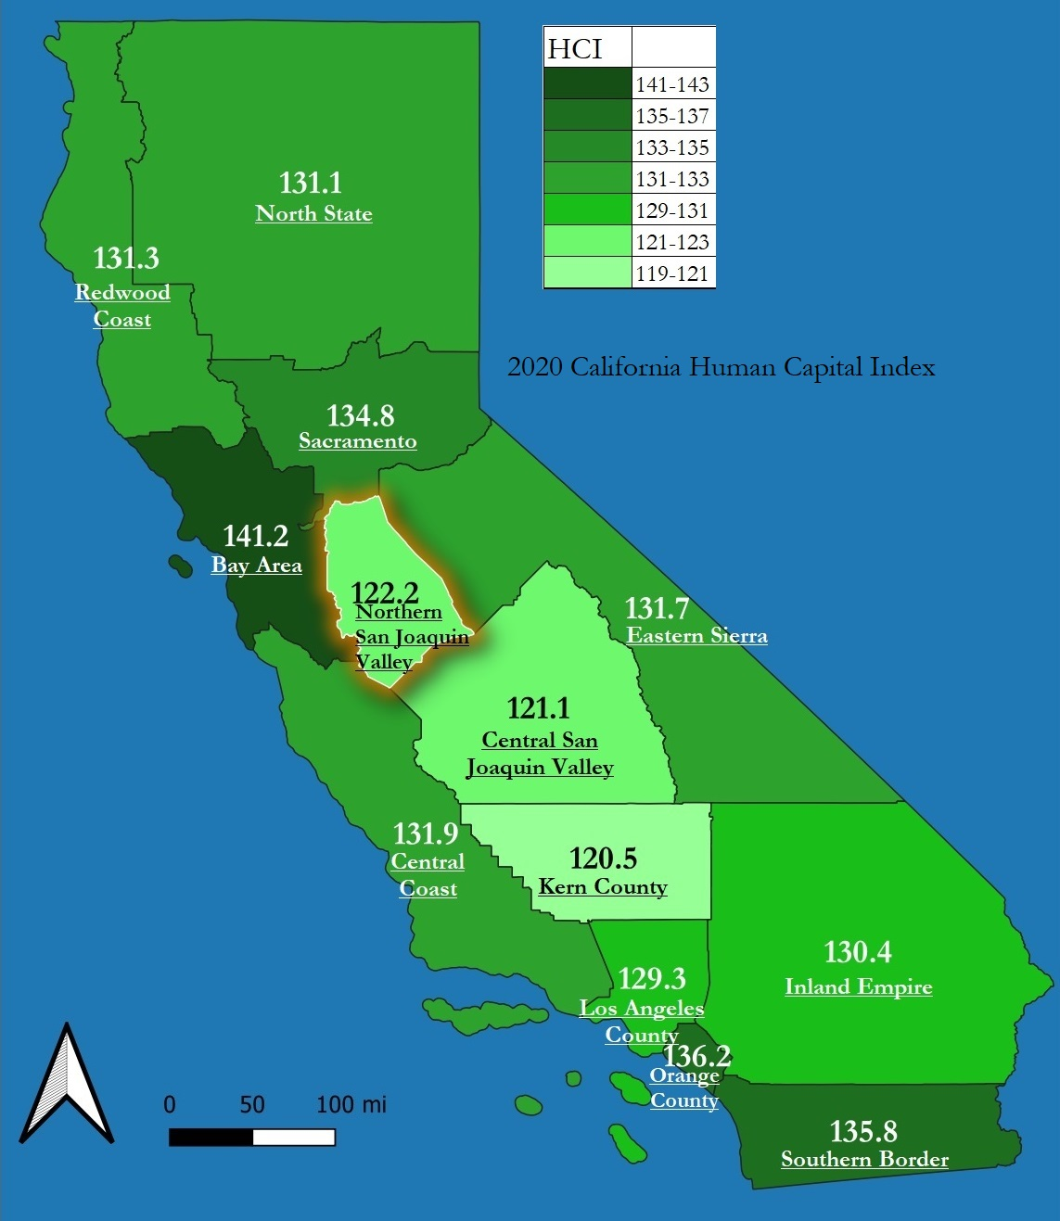
Human Capital Index 2020
Geography | % Change 2015-20
Central San Joaquin Valley | 2.50%
Los Angeles County | 2.10%
Bay Area | 2.10%
Southern Border | 1.80%
Inland Empire | 1.80%
Orange County | 1.80%
Central Coast | 1.80%
Kern County | 1.60%
Sacramento | 1.40%
Northern San Joaquin Valley | 1.20%
North State | 1.00%
Redwood Coast | 0.80%
Eastern Sierra | 0.60%
In 2020 the NSJV HCI Scores:
San Joaquin => 123.7
Stanislaus => 122.6
Merced => 116.8

Slide 8
Limited English-speaking households
42,830 Limited English Speaking NSJV Households
30,190 Spanish Speaking (70%)
12,640 Other Languages (30%)
 | % Limited English
NSJV | 8.7%
San Joaquin County | 8.5%
Stanislaus County | 7.4%
Merced County | 12.2%

