Slide 1
You have a housing element, Now what?
SJV Policy Conference
April 25, 2023

Slide 2
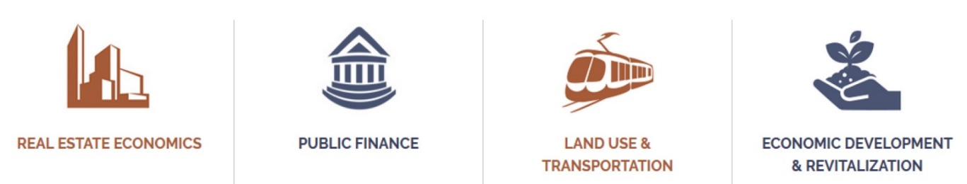

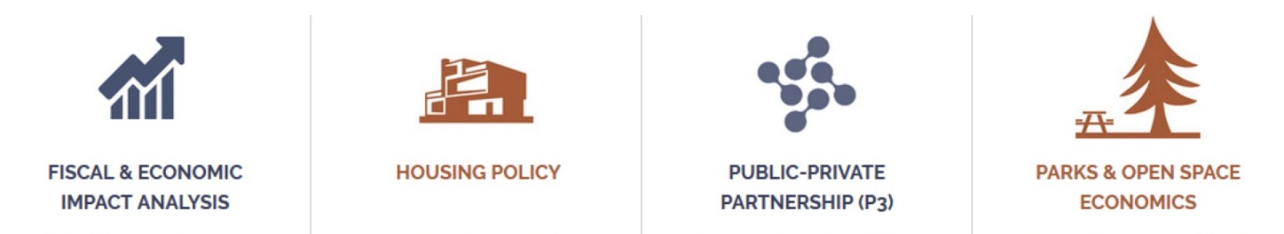
About EPS
Speaking: Ryan M. Martinez, Associate
EPS is an Oakland-based real estate and urban economics consulting firm founded in 1983
Heavily engaged in housing studies across California
SJV REAP projects discussing today:
  Housing Market and Demographic Analysis (2021 – 2023)
  Inclusionary Housing Analysis (In progress)
  Condominium and Attached Housing Analysis (In progress)

Slide 3
Sjv housing market analysis
SJV is among the fastest-growing regions in CA due to strong rates of natural increase (highest birthrates in the state) and foreign immigration.
  Growth concentrated on edges and in center
As in much of the state, the cost of living is rising.
  Population growth has outpaced housing production
  Labor earnings are rising; housing prices are being bid up
  As a result, larger households are forming
The current housing market is dominated by single-family detached, but multifamily activity exists in clusters.
State demographic forecasts suggest SJV needs a higher pace of development over the next 25 years compared to the ≈370K units built over the last 25 years.

Slide 4
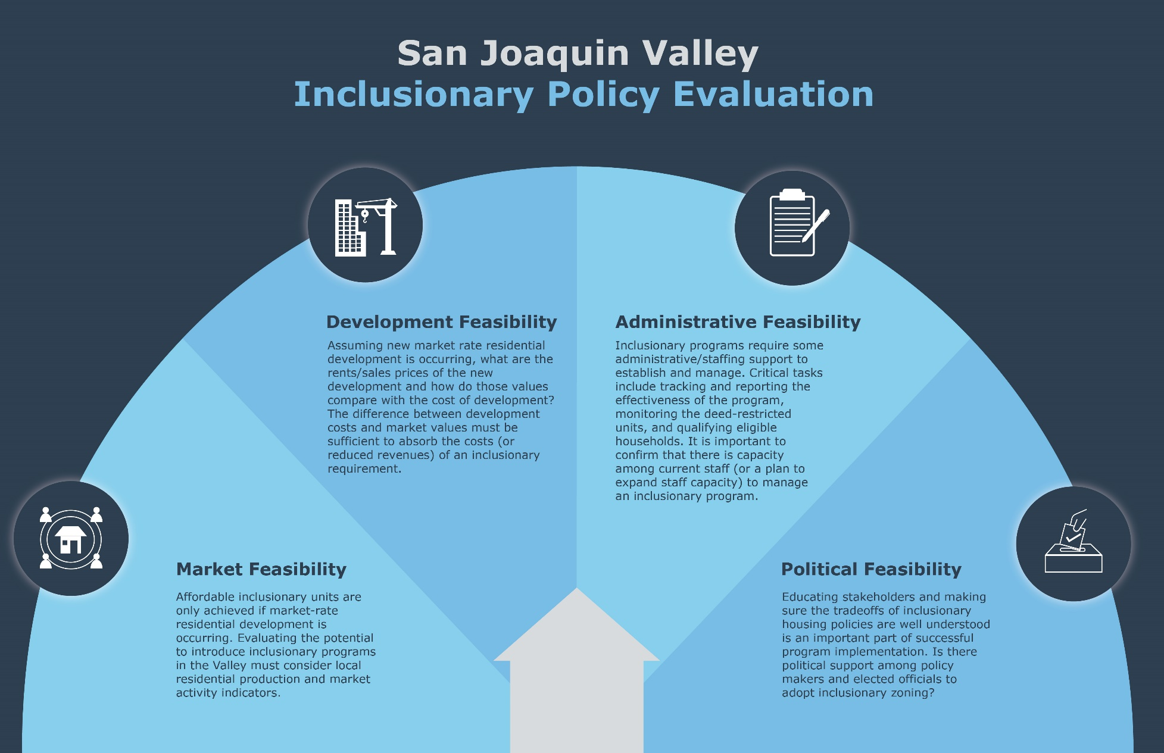
SJV Inclusionary housing analysis

Slide 5
SJV Inclusionary housing analysis
Many cities in the SJV have high market-rate 6th Cycle RHNA requirements, and inclusionary zoning provides an opportunity to “feed two birds with one seed.”
The SJV builder community is wary of regulatory barriers to development - inclusionary zoning policies included.
Inclusionary zoning ordinances require robust initial administrative effort and ongoing attention/monitoring and reporting to HCD.
Inclusionary zoning would be most feasible in jurisdictions where market values are sufficiently higher than development costs.
Infeasibility does not mean inclusionary zoning will never work.

Slide 6
Sjv Condominium Analysis
Condominiums and attached for-sale housing provide a more affordable and equitable path to homeownership than traditional single-family detached.
Condominiums and attached for-sale housing have not historically “penciled” in the Valley due to the lack of market for it.
  Land costs have been historically low in the SJV, disincentivizing the need to develop denser products
  Consumer preference has favored traditional single-family detached homes
  Builders wary of taking additional risks and going against what’s “tried and true”
A few builders have identified opportunities for attached for-sale projects in locations where the detached market has run hot.
  Valley building community watching closely for proof of concept
Construction defect litigation issues, a statewide problem, looms larger for Valley developers working in a market focused on single-family detached.

