Slide 1
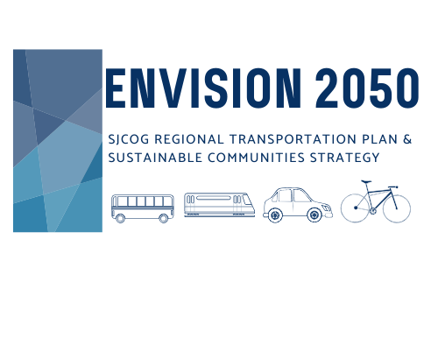
RTP/SCS Overview
About SJCOG
RTP/SCS 101
Get Involved
Questions & Answers
Notes:
Welcome to SJCOG’s presentation about the Regional Transportation Plan and Sustainable Communities Strategy. My name is Ashley Goldlist and I am an Assistant Regional Planner with SJCOG. We thank you for joining us and hope you are remaining healthy during these times. Public involvement is critical to successful regional transportation planning and programming. When the public is engaged in the process, their feedback helps ensure projects address community needs. It also gives the public insight into the planning process and provides a better understanding of the tradeoffs and constraints associated with transportation planning. I want to give a special thanks to my team, Michelle and Christine whose help has been invaluable.

Slide 2

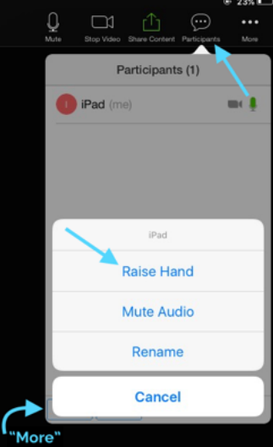
Zoom FAQ
COMPUTER:
1. Click Participants
2. Click Raise Hand command
3. Or tap Chat

Slide 3

Webinar Goals:
Who is SJCOG and what is the RTP?
Why do we do the RTP?
Where are we in the schedule?
How and when to get involved?
Notes:
My goal today is to teach you more about our agency and how we plan for our transportation needs and identify projects to improve the transportation network. Today I will be presenting an overview of what the Regional Transportation Plan is, who administers and prepares it, and inform you of opportunities to get involved.
Before diving in, I want to explain what transportation planning is as it is the core of our work. Transportation planning provides the information, tools, and public involvement needed for improving transportation system performance. It is continuous process that requires monitoring of the system’s performance and conditions

Slide 4
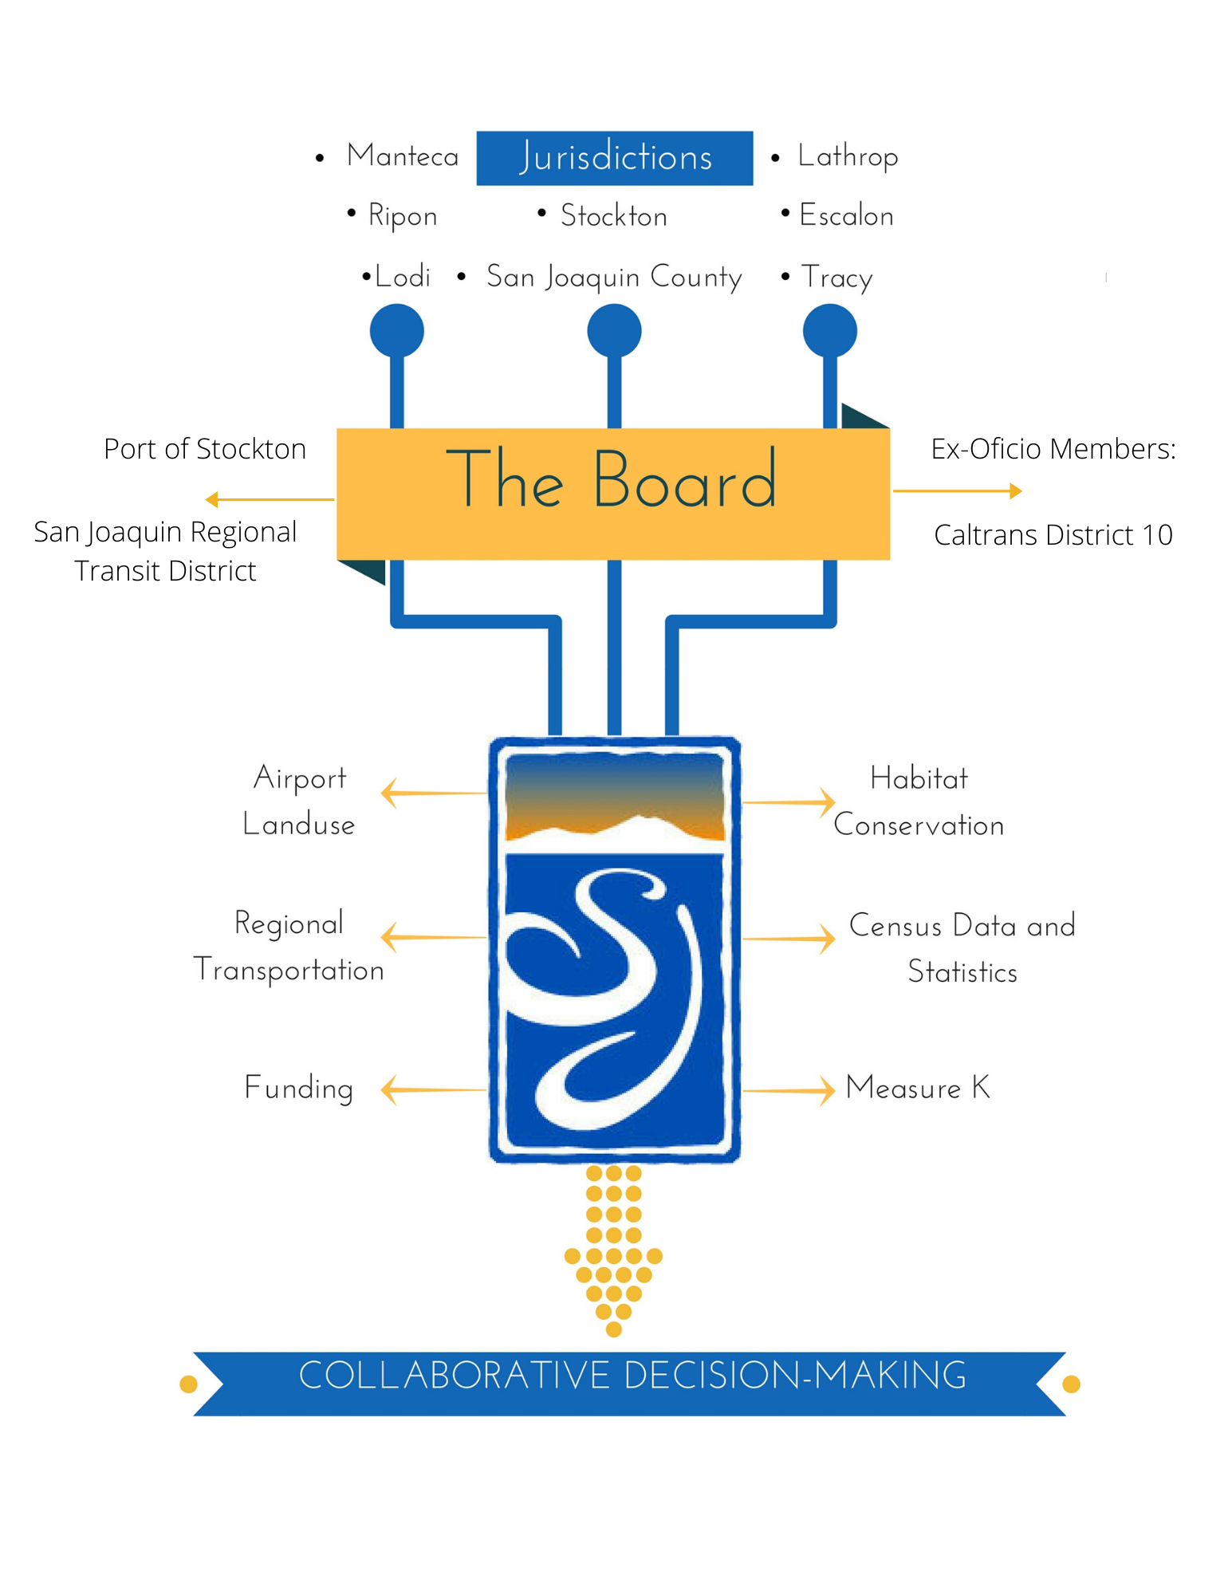
Who is SJCOG?
Metropolitan Planning Organization (MPO)
Regional Transportation Planning Agency (RTPA)
Joint Powers Authority
Council of Governments
Notes:
As I mentioned, I work for the San Joaquin Council of Governments.
As a regional convener, SJCOG has many roles as an agency. Federally designated as a Metropolitan Planning Organization (MPO), SJCOG is comprised of a policy board to carry out transportation planning processes. Similar to MPO responsibilities, SJCOG is also a state designated Regional Transportation Planning Agency (RTPA). RTPAs are also responsible for carrying out transportation planning processes and planning documents. Unrelated to transportation planning, SJCOG is an active Joint Powers Authority (JPA). Created in 1968, SJCOG’s role as a JPA is to foster intergovernmental coordination within San Joaquin County, neighboring jurisdictions, the other regional agencies in San Joaquin Valley, the state of California, and various Federal agencies. Lastly, SJCOG is a Council of Governments (COG), which allows for governance of regional and interlocal issues. The purpose of a COG is to establish a consensus about the needs of an area and the actions needed to solve local, regional, and interlocal problems. While a large portion of SJCOG’s role is related to transportation, SJCOG also carries out a number of activities not related to transportation, such as air quality management, regional planning studies, census data, or regional housing.
Regarding regional housing, SJCOG promotes strategies to increase the supply of, and ensure access to, a variety of housing choices for all residents of the region. As the designated Regional Transportation Planning Agency for San Joaquin County, SJCOG’s role is to administer and allocate federal funds for public transit and possible road and street projects, as well as adopt a Regional Transportation Plan and Sustainable Communities Strategy, which considers the integration of state and federal transportation investments with local land use planning. Additionally, the State authorizes SJCOG to determine each local jurisdiction’s “fair share” of affordable housing throughout the region.
he MPO is made up of representatives from the jurisdictions, the Board of Directors, and ex-oficio members. The Board of Directors is composed of Mayors, Council members, district supervisors. The Board includes ex-oficio members, that cannot vote. They are representatives from Caltrans, San Joaquin Regional Transportation District, and the Port of Stockton. The Board of Directors establishes transportation policies and programs by approving funding to build transportation improvements.
Transportation planning is about more than transportation. It includes Land use, the Clean Air Act and air quality standards, Americans with disabilities act, habitat conservation, census data and environmental justice issues. SJCOG works with public committees and task forces, made up of citizens and community groups, and attends workshops and public forums, providing input on planning decisions. Successful transportation planning is predicated upon coordination and feedback from multiple stakeholders,
One of SJCOG’s many responsibilities is to prepare and administer the Regional Transportation Plan which will be the focus of this presentation.

Slide 5
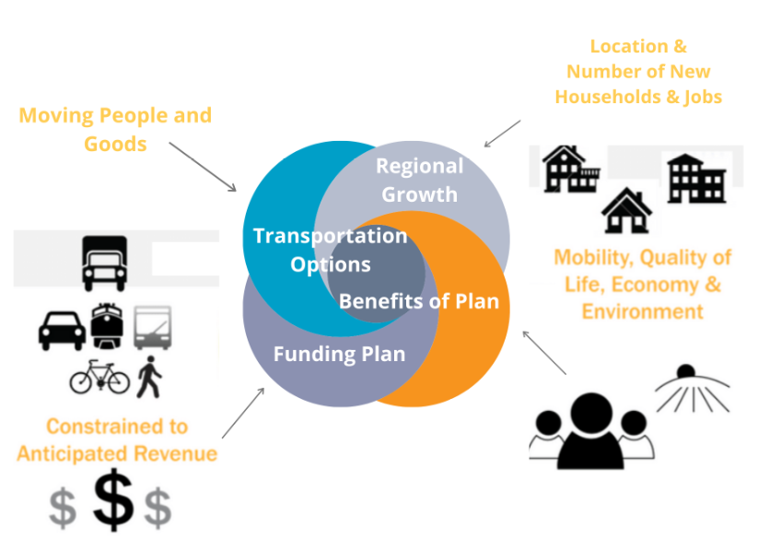
What is the RTP?
Notes:
The Regional Transportation Plan is a state and federally required document that serves as a long-term framework of a region’s transportation system.
The plan is a shared vision for all of the cities and the county that considers multiple methods of transportation and land use , a revenue and investment plan, and transportation projects. The plan is prepared with input from interested parties and provides reasonable opportunities for these parties to comment on the content of the RTP.
The plan covers over 20 years of efforts to improve mobility through transportation infrastructure projects and strategies that is updated every four years. By updating the document every 4 years we can look at the previous RTP and measure how we’ve done and identify the challenges to successful implementation.
The RTP identifies and analyzes transportation needs based on four key planning assumptions.
These assumptions are transportation options, regional growth, plan benefits, and balanced funding.
Regional growth takes into account the latest population and employment trends to make travel projections.
The benefits of the plan refers to goals for improved air quality, economic development, and environmental benefits that arise from a more efficient and well planned transportation system. The plan includes air quality and greenhouse gas targets that can improve health and quality of life through cleaner air.
Transportation options refers to multiple ways to move both people and goods through the region setting current and future regional transportation priorities.
A healthy transit system has a diverse offering of travel options whether you get around by car, on transit, walk or ride a bike.
The Plan works to improve your mobility in the region and serves as a guide for achieving balanced investment in all modes of transportation.
The funding plan is a very important component of the RTP as projects much be listed in the RTP to receive federal and state transportation money. The funding plan must also be constrained, meaning that the money we are planning to spend must equal the revenue we are expecting to receive from state, federal, and local sources.
Cost effectiveness and short- and long-term availability of funding

Slide 6
Poll Time!
Have you ever been involved with anything SJCOG related?
2022

Slide 7
What is the RTP/SCS?
Policy Element
Sustainable Communities Strategy
Financial Element
Action Element
Notes:
The RTP is broken down into the Policy Element, the Sustainable Communities strategy, the financial element and the action element.
In the next following slides I will explain SJCOG’s RTP strategies and examples of how we are implementing these strategies. I will also go into greater detail about the financial portion of the RTP and the various sources of funding available to MPOs. Lastly, I will explain the Sustainable Communities Strategy

Slide 8
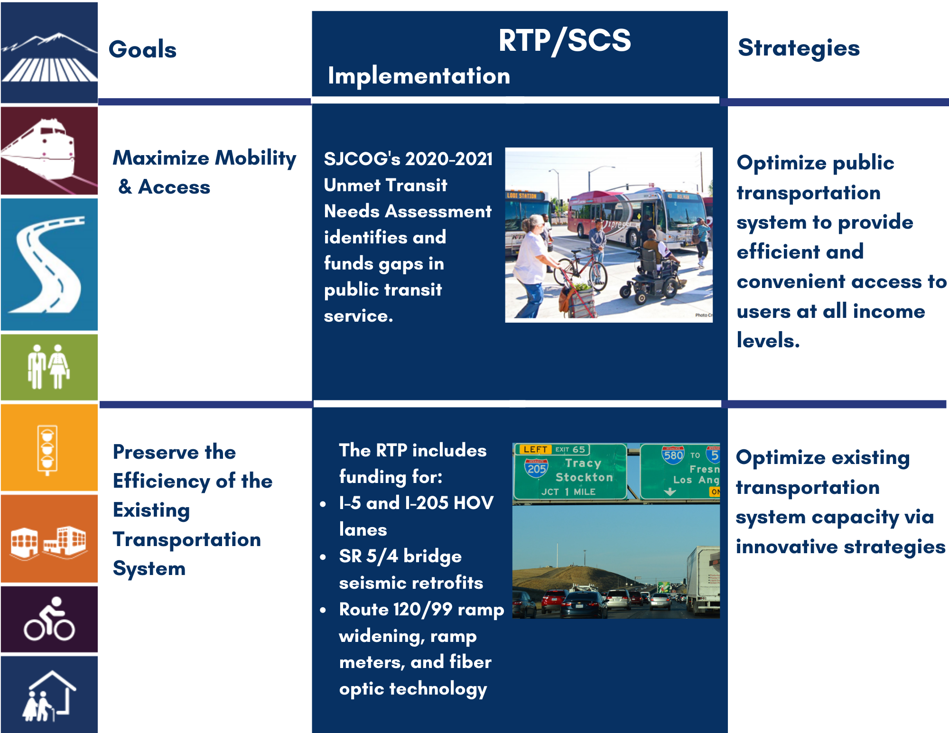
Policy & Action Element
Notes:
In the following four slides, the RTP’s strategies are listed on the left side of the chart. The RTP seeks to maximize mobility by improving the transportation to be more efficient and affordable.
An example of SJCOG implementing this strategy is the Unmet Transit Needs assessement we perform every year that uses input from community groups and RTD to find gaps in public transit.
SJCOG works towards preserving the existing transportation system by using innovative strategies. This is demonstrated with our funding of I-5 and I-205 HOV lanes, bridge retrofits, and ramp metering.

Slide 9
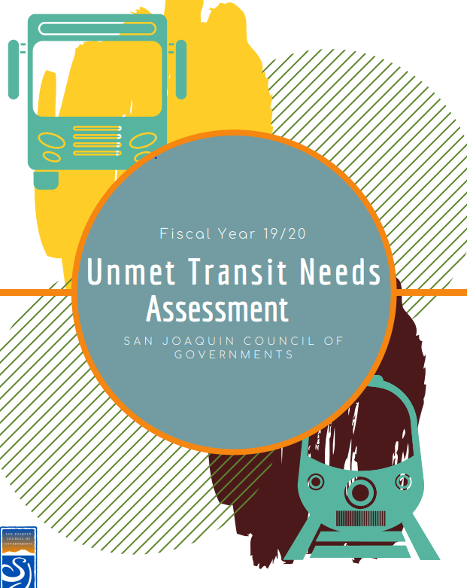
UTN 2020-2021 will be approved this summer.
2022

Slide 10
I-205 Future HOV Lanes
2022
Notes:
This project implements the RTP Strategy of optimizing existing transportation capacity with innovative strategies.
This particular project is incomplete as of now, but will be complete sometime in the RTP time frame.

Slide 11
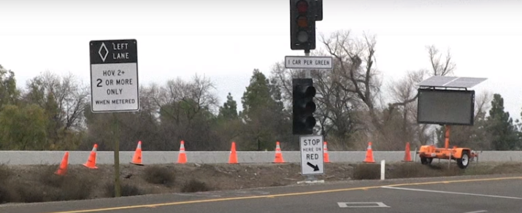
Jack Tone Round About
2022

Slide 12
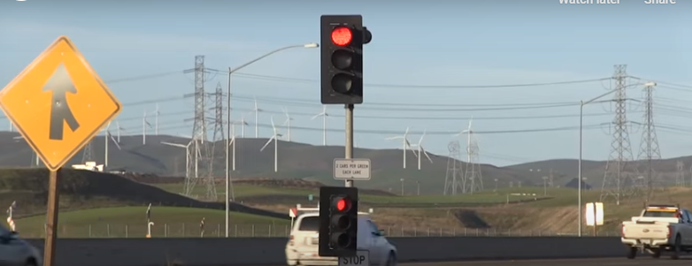
2022
Notes:
Caltrans will perform field surveillance, collect traffic data, adjust meter timing rates and monitor ramp queues.

Slide 13
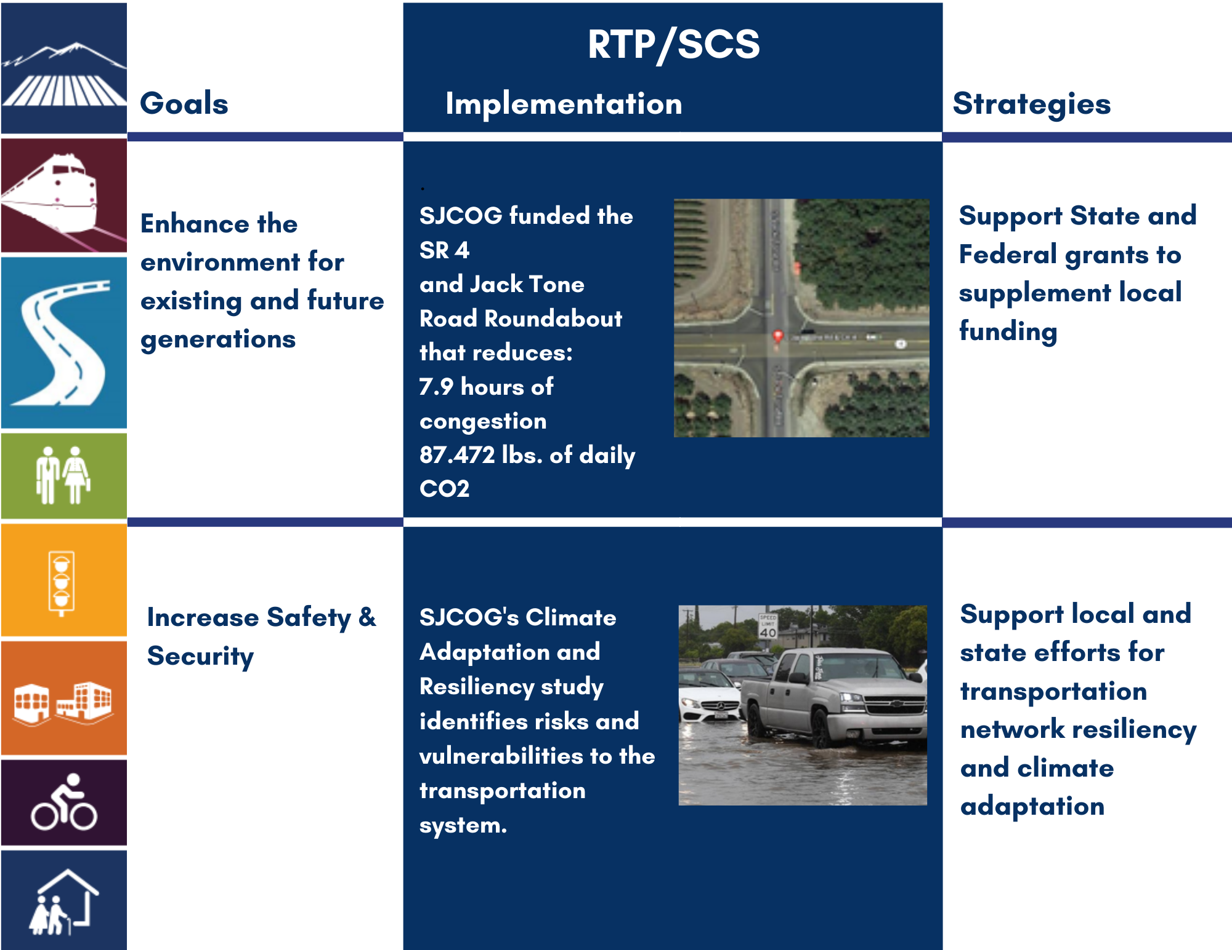
Policy & Action Element
Notes:
We also work to enhance the environment by using state and federal grants in addition to local funding like Measure K. For example, we included funding for a roundabout in the previous RTP at Jack Tone Road that improves traffic flow and reduces traffic by 7.9 hours and decreases 87 lbs of carbon dioxide released.
Our RTP also strives to increase safety and security. We have implemented this strategy through a Climate Adaptation and Resiliency study that identifies risks to our transportation system. This will allow us to plan and fortify our transportation system for years to come.

Slide 14
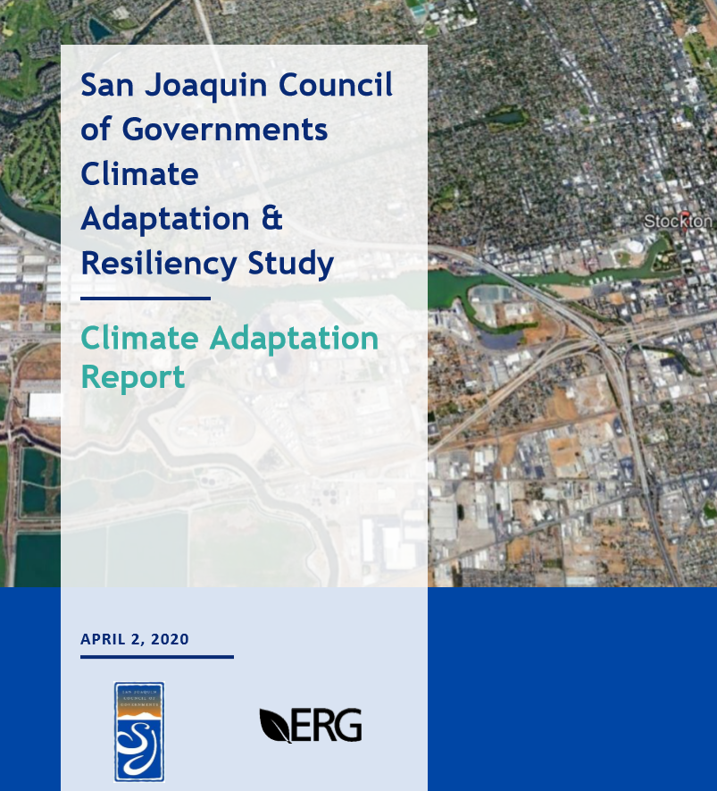
Strategy:
Support local and state efforts for transportation resiliency.
2022
Notes:
Goal:
Increase Safety & Security:
Phase I identifies structures we should prioritize for climate resiliency improvements.

Slide 15
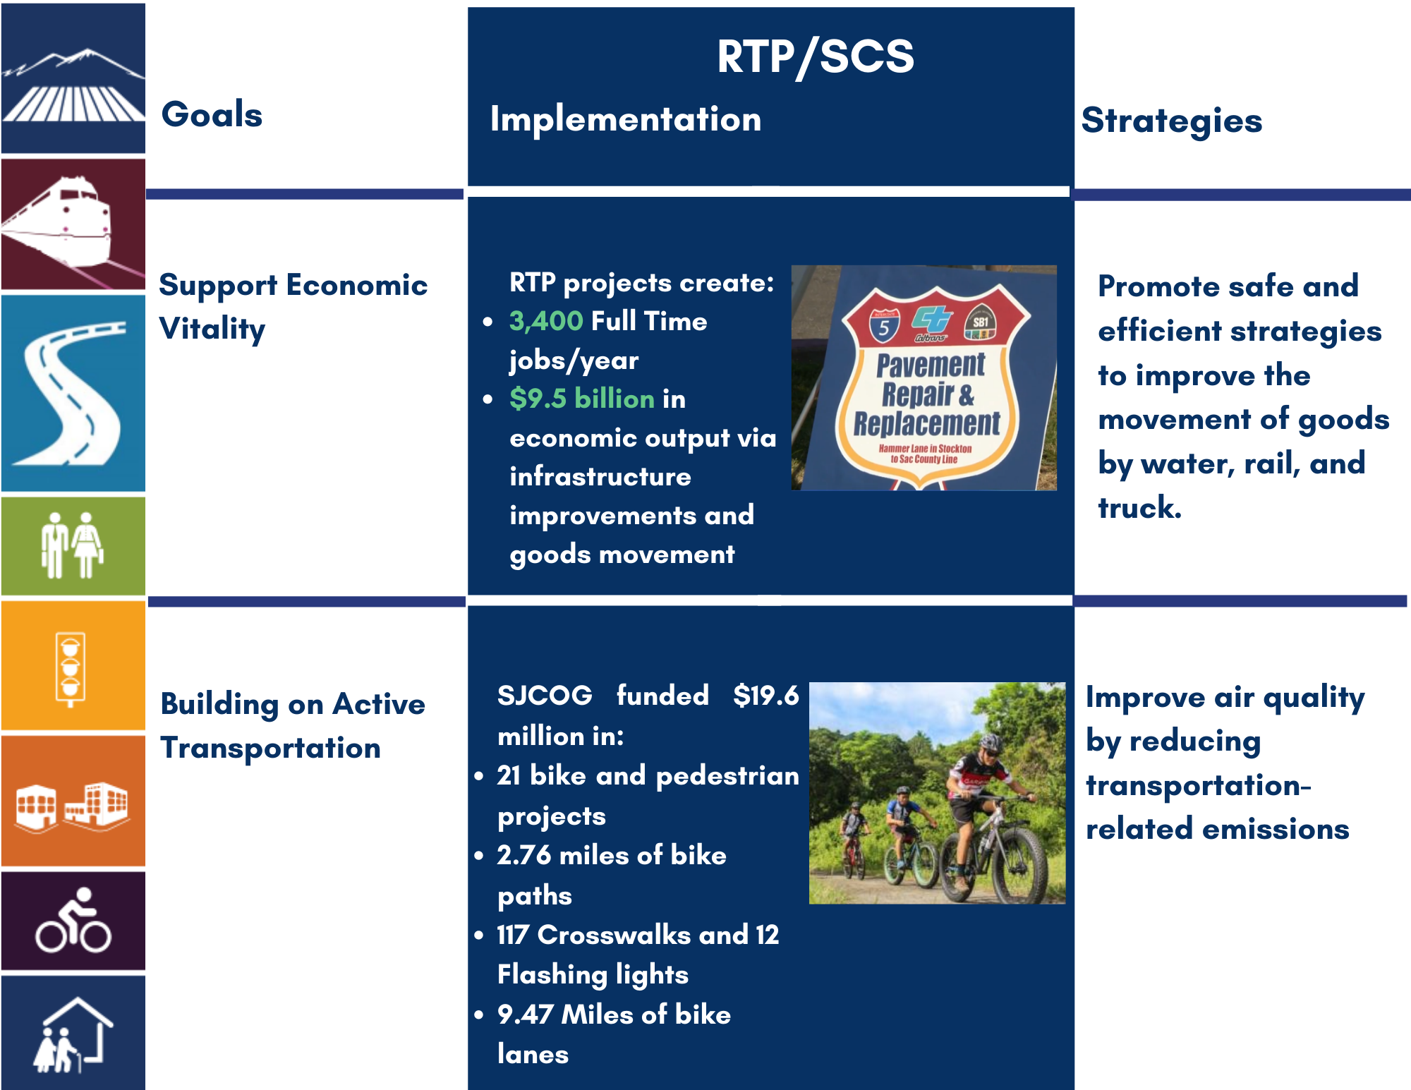
Policy & Action Element
Notes:
Transportation also plays an important role in promoting economic development in our region. The RTP seeks to improve one of the most important business sectors in our region by improving movement of goods by water, truck, and rail. As result, the RTP created 3,400 full time jobs a year and 9.5 billion in economic development from improved transportation infrastructure.

Slide 16
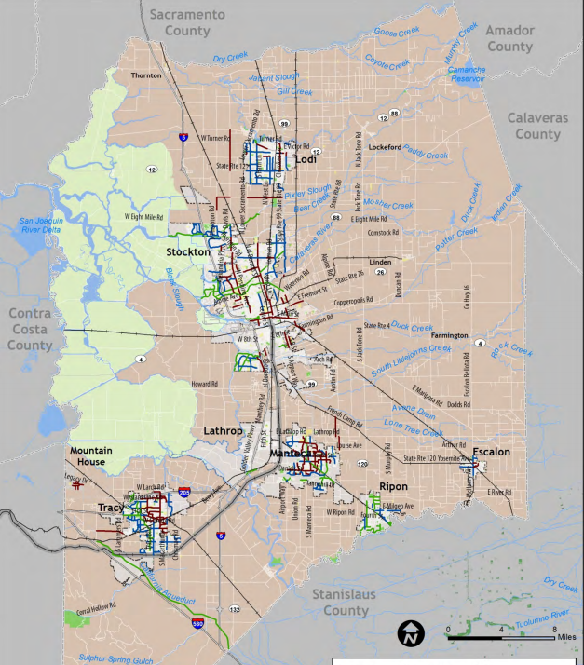
Regional Existing Bikeways
Notes:
San Joaquin County is developing a Bicycle Master Plan Update to identify the safest and most convenient bicycle routes. This project fulfills the RTP strategy of improving air quality by reducing transportation related emissions be building active transportation.

Slide 17
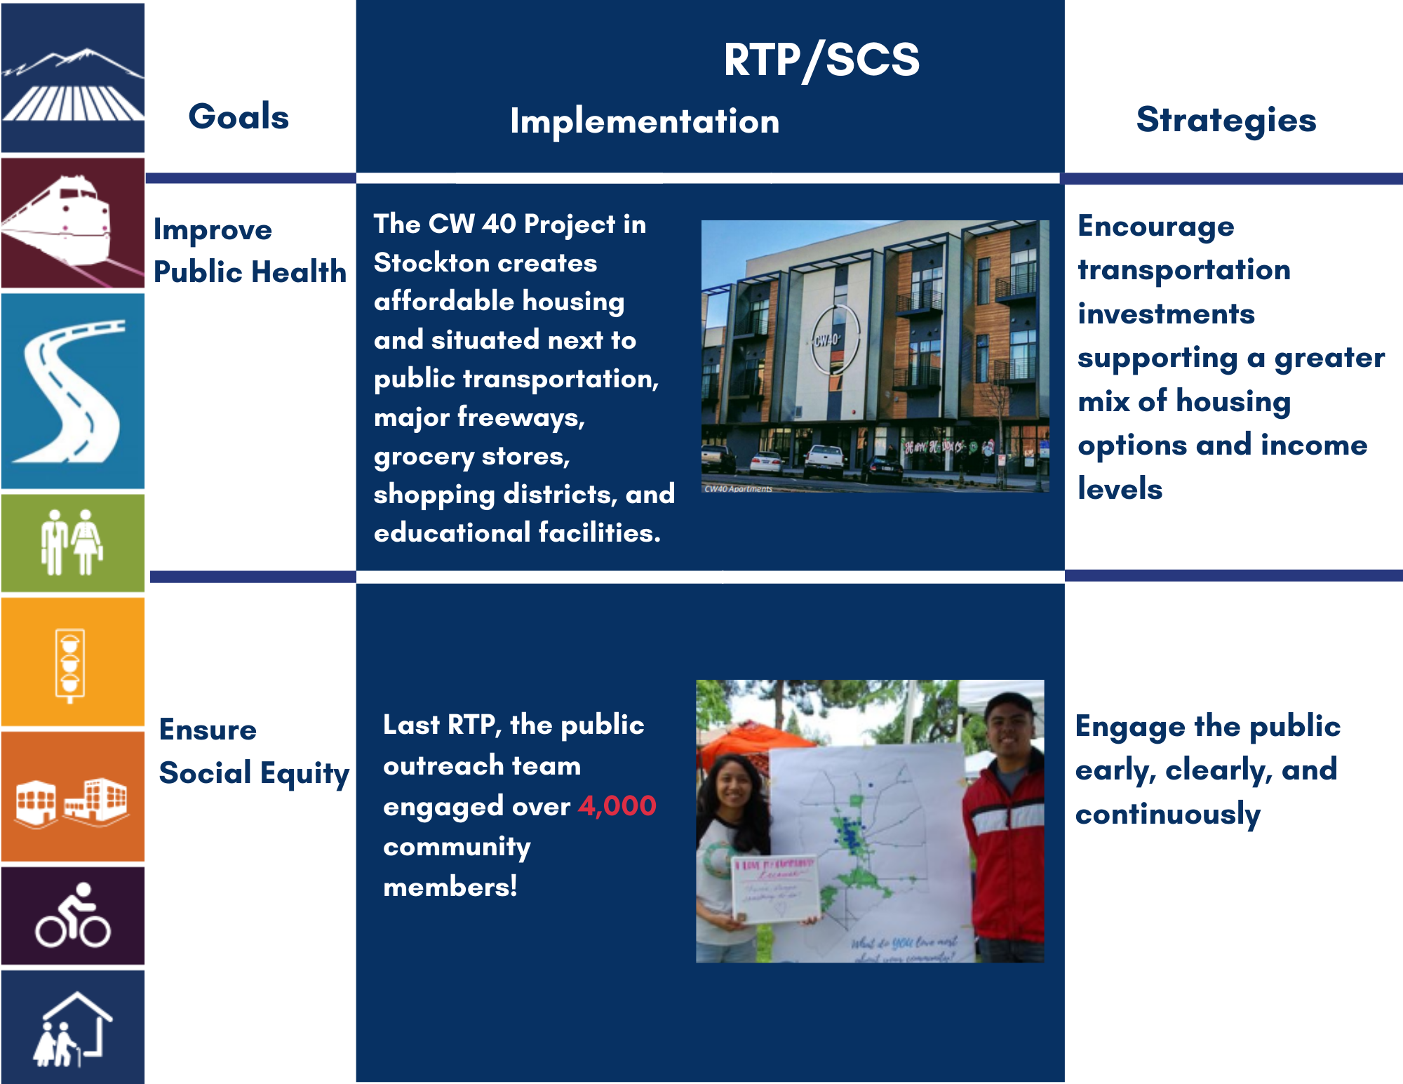
Sustainable Communities Strategy
Notes:
The Sustainable Communities Strategy is a new component of the 2050 RTP developed alongside Senate Bill 375.
The SCS requires our organization to prepare this strategy in addition to our policy, action, and financial obligations.
The SCS demonstrates how the RTP will meet greenhouse gas reduction targets set by the California Air Resources Board.
We demonstrate compliance by showing how our region’s development patterns and transportation network and programs will work together to reduce greenhouse gas emissions for cars and light trucks.
The SCS is broken down into four components. These components are land use, transportation networks, transportation demand management strategies, and transportation system management programs.
An example of a SCS strategy is improving land use to build housing around transportation centers or by freeways. This reduces the need for person vehicles and reduces the amount of miles travelled by vehicle.

Slide 18
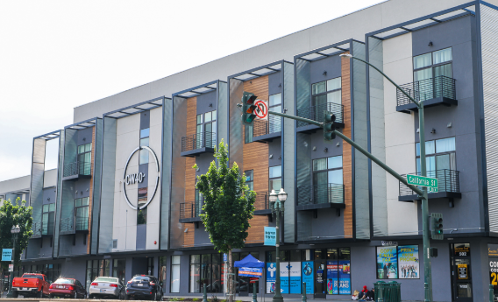
CW-40 Housing across the street from SJCOG
2022
Notes:
Building housing around transportation improves public health by reducing the need for a personal vehicle leading to less air pollution emissions.

Slide 19
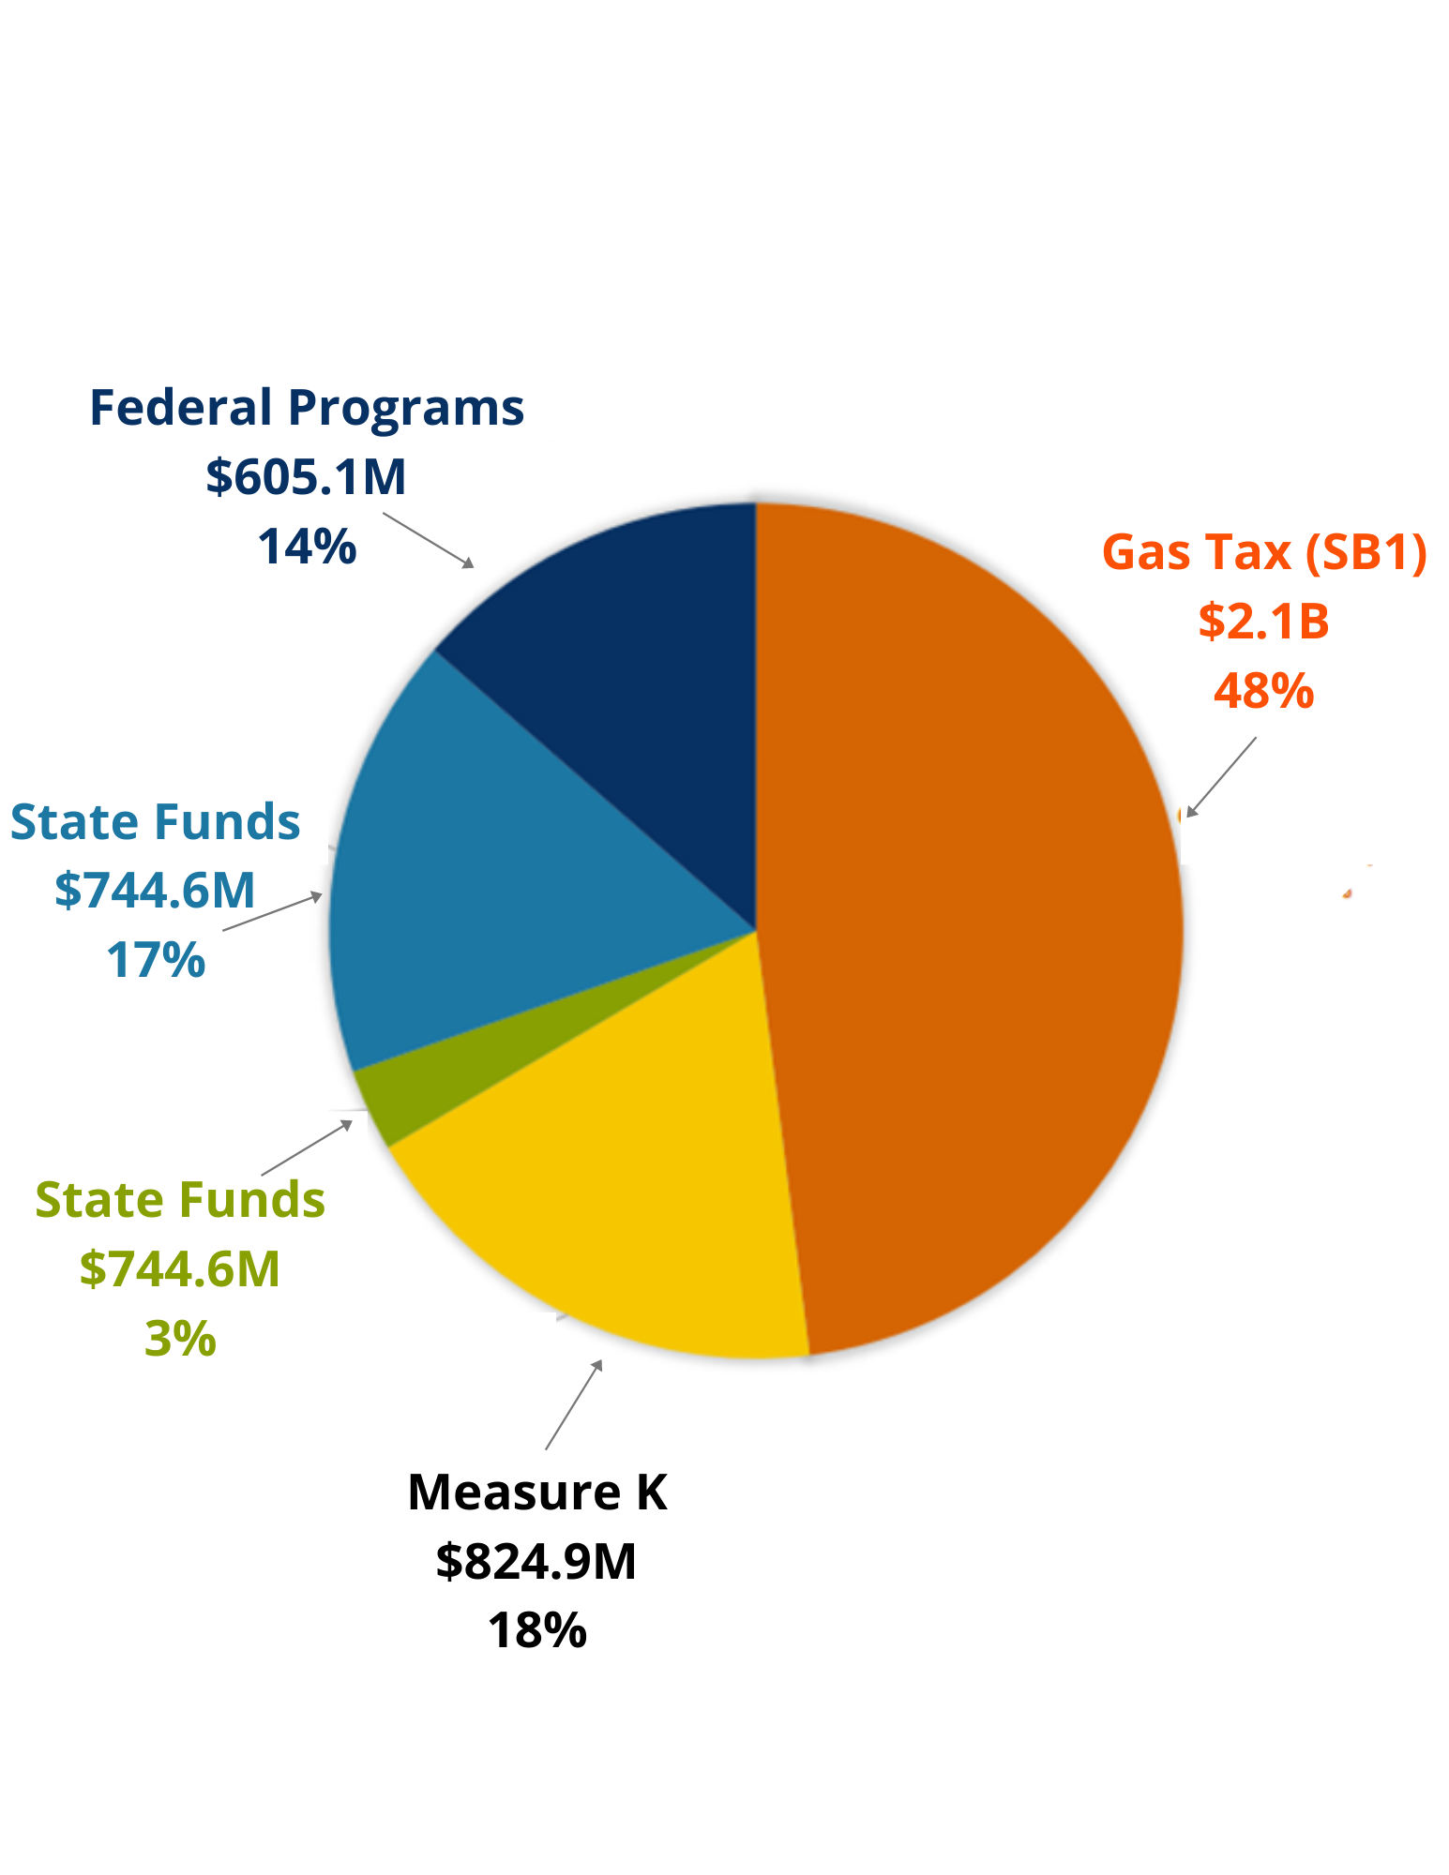

Financial Element
2018 RTP Funding Sources
20 years of funding
Transportation Projects and Strategies
Federal, state, local, Measure K funding sources
Projected $ based on economic, demographic, and legislation
Funds must = Committed Projects
Notes:
The final component of the RTP is the financial element. The plan contains 20 years of funding sources.
Transportation investments in the Plan are based on an estimate of available funding through 2042 including reasonably expected federal, state, and local revenue sources.
SJCOG makes projections of what funds we expect to receive and spend on projects by looking at historical patterns of funding from the federal, state, and local revenues in addition to future economic, demographic, and legislative conditions.
We develop this with input from local transit agencies, local jurisdictions, and state and federal agencies so are estimates are reasonable.
Once we determine the funding amount we must demonstrate that the amount of dollars we expect to spend on projects does not exceed the amount of funds estimated to be available.
Thus, we cannot have unlimited projects. Projects selected must effectively accommodate future transportation and perform environmental benefits.
Some examples of Transportation Projects included in the RTP are the recently completed I-5 widening, DIBS, and freeway service patrol.
Programs Such as dibs Your Way (formerly Commute Connection), Freeway Service Patrol

Slide 20
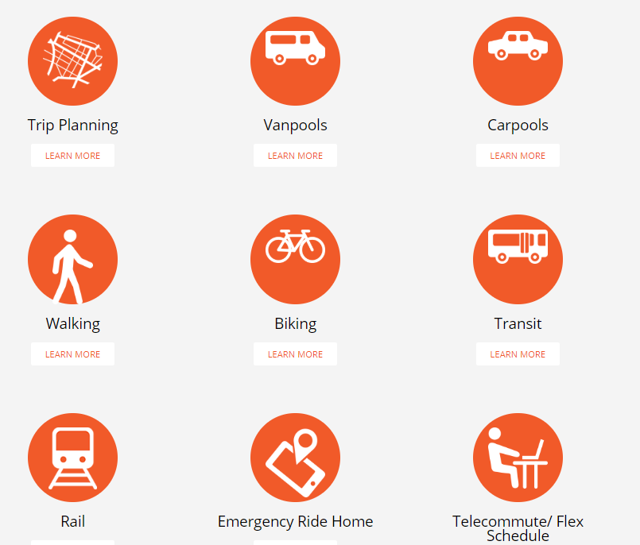

2022
Notes:
Building housing around transportation improves public health by reducing the need for a personal vehicle leading to less air pollution emissions.

Slide 21

Regional Transportation Plan (RTP) Basics - Why
Projects MUST Be Listed in the RTP
Try to meet SB 375 ghg reduction targets
Required By Federal and State Law
Comply with Clear Air Act Standards
Notes:
As I mentioned before, the RTP is required by the Federal and State law but there are other reasons why we are obligated to complete the RTP.
The RTP is required by federal and state law and is the mechanism by which we receive funding for transportation projects.
In addition, the RTP must meet Clean Air Act standards that regulates all sources of air emissions and protects public health and the environment.
While it is not required to meet SB 375 greenhouse gas targets, the Plan is encouraged to meet greenhouse gas targets set by the California air resource board.
This in turn promotes a better quality of life for residents due to reduced heart and respiratory problems from cleaner airt and increased employment opportunities from more accessible transportation.
Furthermore it is federally mandated that the RTP must promote safe, and regionally integrated efficient transportation.

Slide 22
Regional Transportation Plan (RTP) Basics - Why
Promote safe and efficient transportation system
Promote integrated regional & multimodal plan
Promote quality of life, economic development, co-benefits
Notes:
As I mentioned before, the RTP is required by the Federal and State law but there are other reasons why we are obligated to complete the RTP.
The RTP is required by federal and state law and is the mechanism by which we receive funding for transportation projects.
In addition, the RTP must meet Clean Air Act standards that regulates all sources of air emissions and protects public health and the environment.
While it is not required to meet SB 375 greenhouse gas targets, the Plan is encouraged to meet greenhouse gas targets set by the California air resource board.
This in turn promotes a better quality of life for residents due to reduced heart and respiratory problems from cleaner airt and increased employment opportunities from more accessible transportation.
Furthermore it is federally mandated that the RTP must promote safe, and regionally integrated efficient transportation.

Slide 23
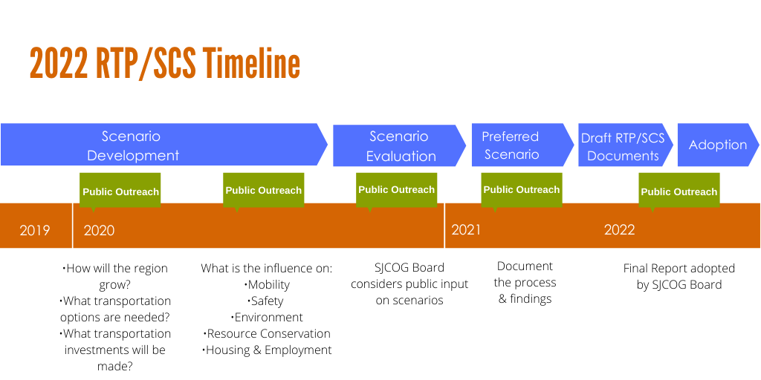
Notes:
This is a timeline of the process SJCOG employs to meet its RTP obligations.
We prepare for the upcoming RTP by doing public outreach and determining how the region will grow over twenty years.
This will help guide us towards what transportation investments we should make.
We consider impacts on mobility, safety, housing, and employment.
Our Board of Directors considers the different scenarios we have projected to see in the future.
Upon approval, we choose the scenario that has the most consensus and present to the board for approval.
Currently we are at scenario development phase with plans to adopt the RTP in 2022.

Slide 24
Poll Time!
How do you get around San Joaquin County?
2022

Slide 25
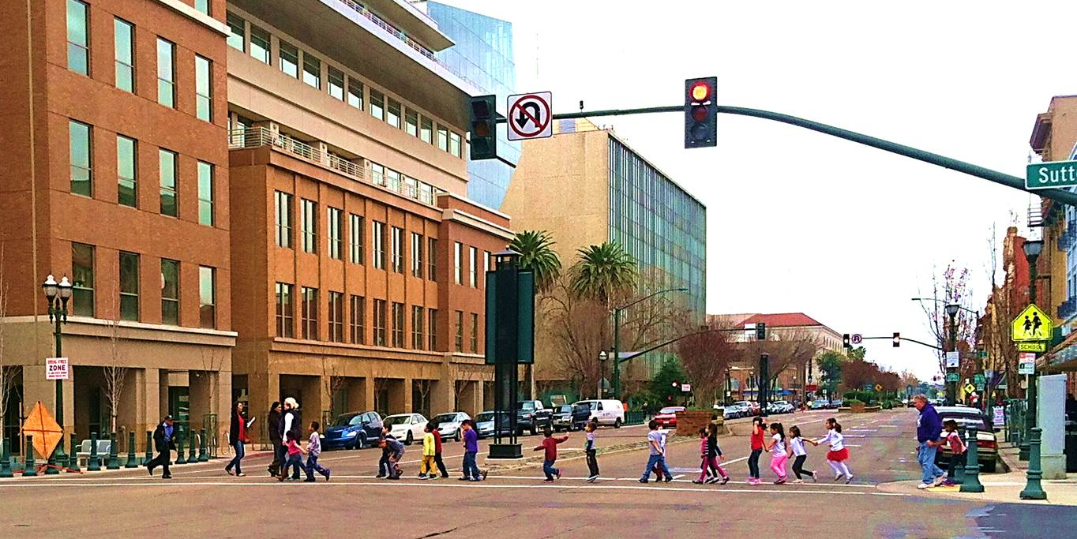
Get Involved
2022
Notes:
Public participation and input is an important part of the regional planning process. Thank you for being here and for engaging with SJCOG about the future of the region.
Your feedback tonight will be shared with our Board of Directors, who will then take what you’ve shared into consideration as they deliberate the investment strategies, funding policies that will shape the next 20 years of San Joaquin County.
This workshop will not be the only opportunity to share your ideas with staff and the board, there will be more through 2021 and 2022 .

Slide 26
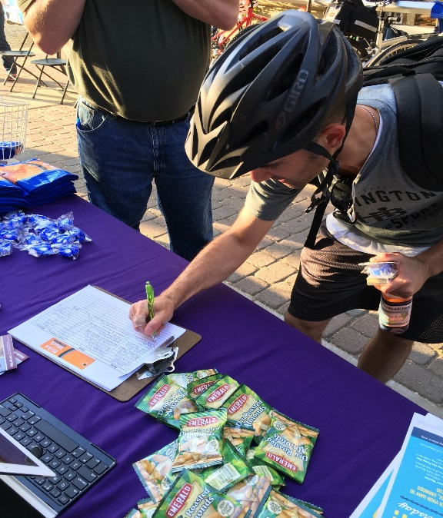
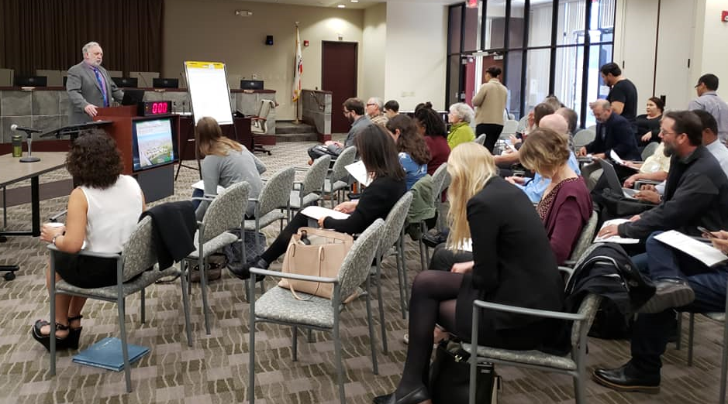

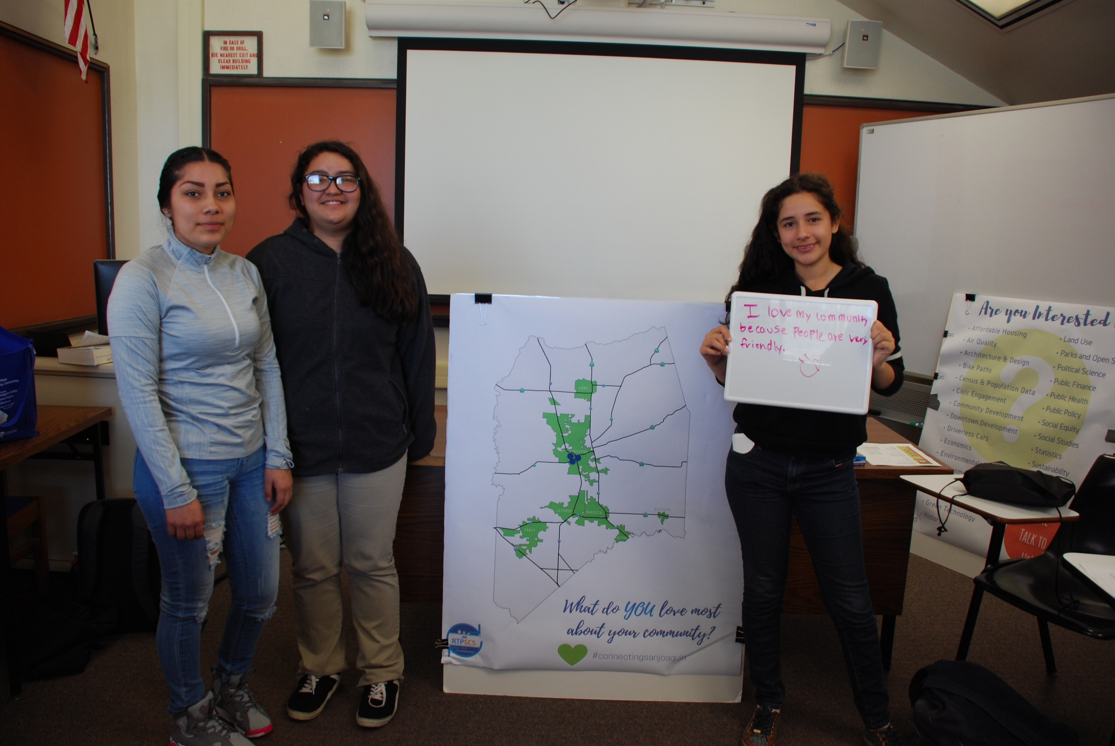

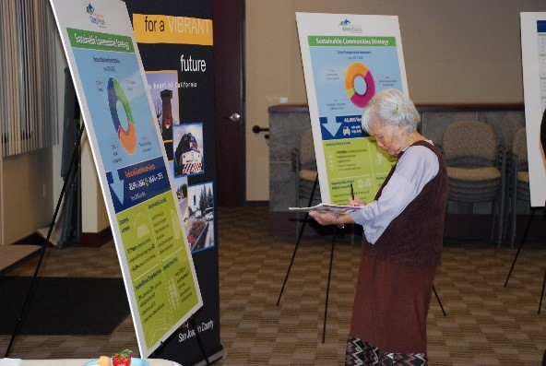
Get Involved!
Sign up for email notifications
Attend virtual meetings
& workshops
Take the online survey
Help us engage your community
Mini Grant Program
Invite SJCOG to events
Notes:
If you’re wondering about ways to stay plugged in or to get involved, here are 6 ways:
Sign up for notifications (if you haven’t, place a check mark next to your email address on the sign in sheet so we can add you to the list)
Attend meetings & workshops about the RTP/SCS..
Be sure to respond to the transportation needs survey
You can give comment at public hearings or sjcog board meetings
Invite SJCOG to your community events

Slide 27
Notes:
SJCOG recently announced a mini grant that will conduct outreach acitivities with the public about the RTP.
The grant is up to $5000 and we are looking for assistance from community-based organizations, faith-based organizations, youth-serving institutions,. to gatherg public input into the preparation of the 2022 RTP/SCS.

Slide 28
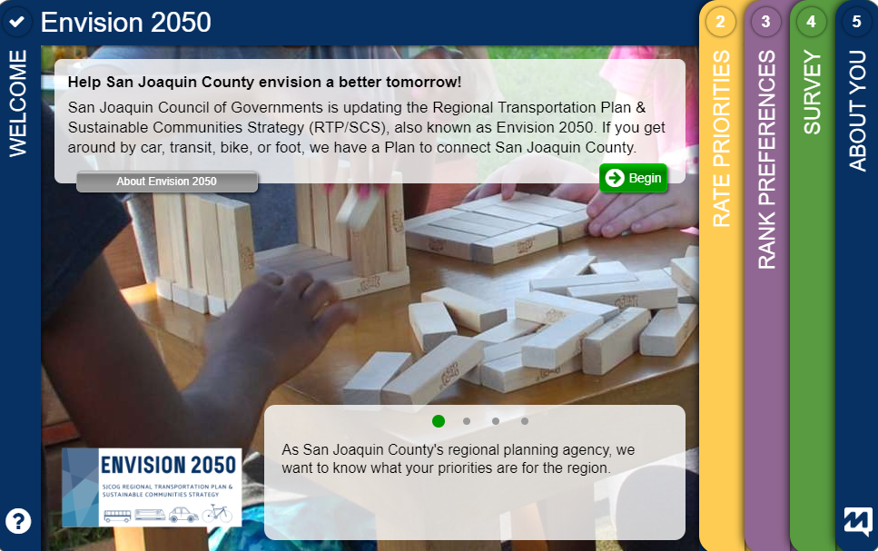
Get Involved
MetroQuest Survey
Early May 2020
www.sjcog.org/rtp
Notes:
In early may We are launching a short survey to provide feedback about the different ways you get around San Joaquin County.

Slide 29






enn
Follow SJCOG on social media:
Join the conversation #connectingSanJoaquin #Envision2050
www.sjcog.org/rtp
www.sjcog.org

Slide 30

Questions & Answers
Notes:
Thank you very much for your time and attention.

Slide 31
Contact Us!
Christine Corrales, Associate Regional Planner
corrales@sjcog.org
Michelle Prince, Assistant Regional Planner
prince@sjcog.org
#connectingSanJoaquin
#Envision2050
Notes:
Envision 2050 update image

