Slide 1
Youth and Adult Apprenticeship Opportunities in California
John Dunn – Assistant Secretary of Labor for Apprenticeship & Worker Training

Slide 2
Definitions
Internship – short term, preferably paid, work based learning experience generally connected to a potential career
Pre-Apprenticeship – more formal classroom and/or work based learning that provides foundational training leading to a Registered Apprenticeship program
Apprenticeship – focused classroom instruction combined with a minimum of 1 year of paid work experience that tracks skill acquisition and competency via EMPLOYER identified work processes and observation. Registered and approved by state or federal agency

Slide 3
How does an apprenticeship work?
Some combination of classroom instruction and On the Job Training
Front loaded
Classroom Hours
144 minimum
per year or competency based
Completion
Credential
and Career
OJT timeline – 1500-2000 hours approximately per year, with graduated pay increases over time

Slide 4
Why Apprenticeship?
Formalized, contextualized, post-secondary learning with a proven return on investment
Portable industry recognized certificate of completion verified by the state
Faster school to career path
Enables employers to more easily train unskilled or lower skilled employees into skilled and living wage positions, with better retention
Provides pathway to a career and college

Slide 5
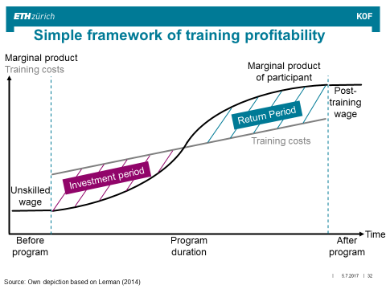
More Why…

Slide 6
Swiss Model
Flexible and Permeable – multiple pathways to a career
Integrated into the educational system
Employer/Industry driven

Slide 7
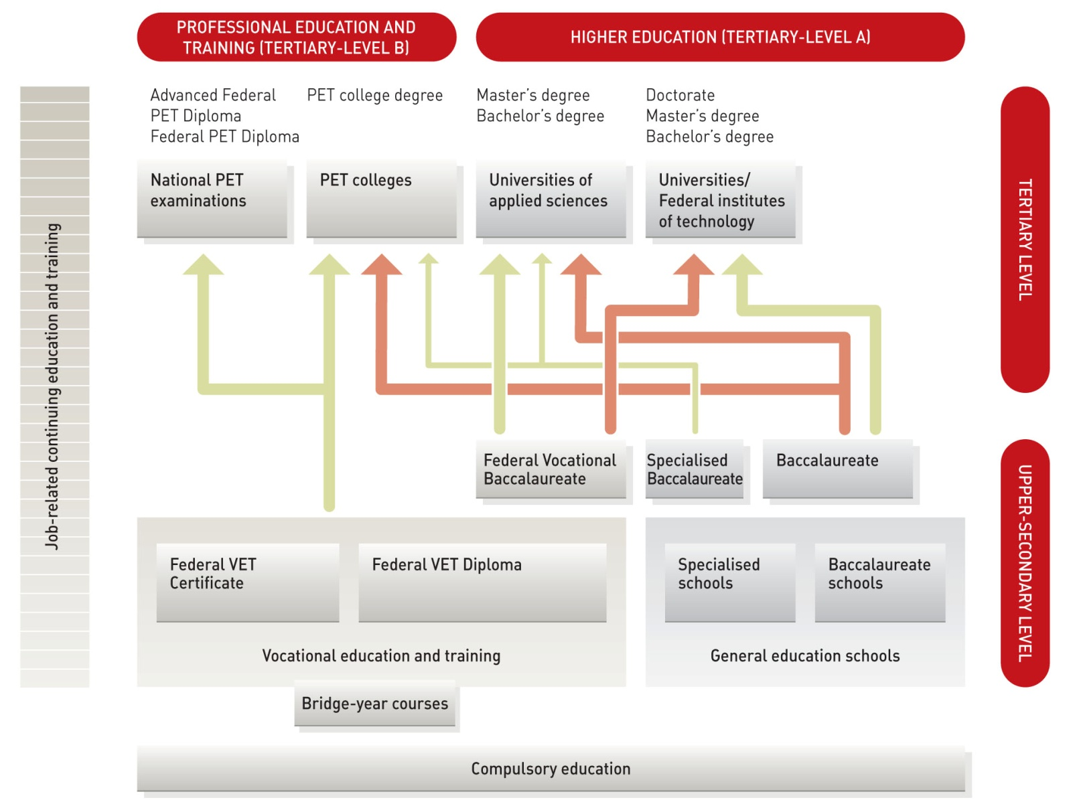

The Swiss Education System – Options & Permeability (From ETH Zurich)
entry
age
20
19
16
23.02.2016
Notes:
The high permeability of the system allows for a multitude of career paths.
For example: The programmes available in higher education (PET) for holders of a VET diploma allow for a wide range of career opportunities, for example in middle and upper management, or as a specialist in a specific field.
Another example: Practically oriented education and training can be combined with academic education. This is highly valued on the job market.
Throughout the system, there are no dead ends: “With every degree there come further education options”. VET thus is a very solid foundation for lifelong learning.
These features make the VET pathway highly attractive for young people.
___
Per year there are 235 000 VET students (upper secondary education);
50 000 PET students (tertiary, higher vocational education and training);
63 000 Universities of applied sciences (UAS) students (tertiary, university level).

Slide 8
California Apprenticeship
Over 84,000 current apprentices, mostly in the Building and Construction Trades and Firefighters
$45 million in last 3 budget years, with an additional $15m this year for
California Apprenticeship Initiative
Focus on creating opportunity for apprenticeship training programs in Healthcare, IT, Manufacturing, Civil Service, etc.
Examples:
- Early Childhood Education, LVN to Registered Nurse (RN), CNC machinist, software tester, IT helpdesk, regional transit (mechanics), culinary, viticulture, industrial maintenance technician

Slide 9
Civil Service Apprenticeships
State of California is largest employer in Sacramento and supports Apprenticeship
Determined IT classification/occupations would be first
Partnership with SEIU Local 1000
PC Support and Financial Services (Auditors and Accountants) next, in partnership with American River College and other Los Rios colleges, Cyber Security to follow
Potential for other classifications being evaluated, including custodial, landscape/maintenance, etc.

Slide 10
Assets and funding
San Joaquin Delta College
San Joaquin County Office of Education
Local school districts and charter schools
All local and county agencies (internships and apprenticeships)
California Partnership Academies – 5 in Stockton, 3 in Lodi, 1 in Galt
Other CTE programs (Weber Institute, Lincoln Tech, Agriculture Academies, etc.)
California Apprenticeship Initiative - $45m to date, $15m new 2018-19
SJ County WorkNet (WIOA)
State Agencies
Federal DOL funding
Private industry/employers
Other non-profits, philanthropic organizations

Slide 11
Questions?

Slide 12
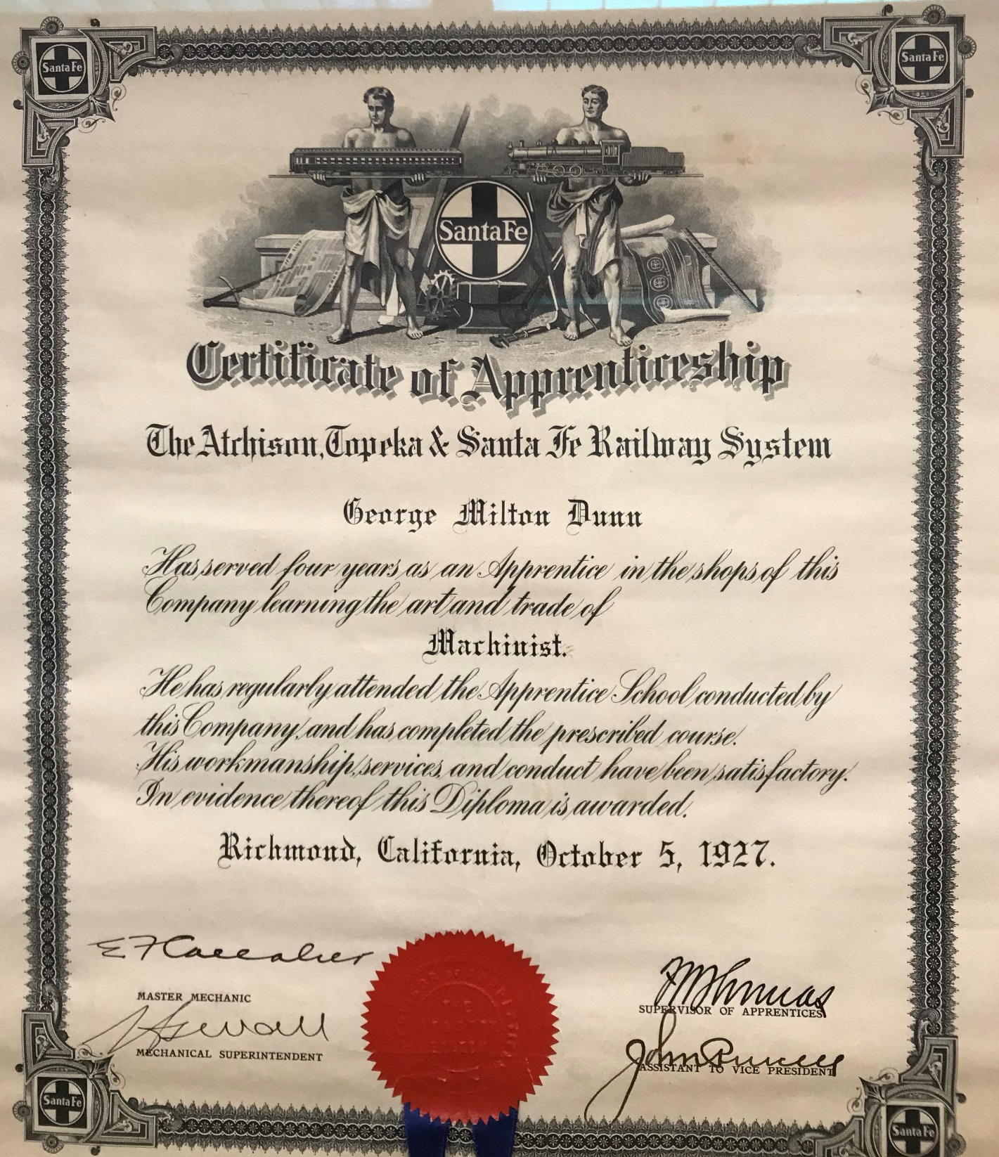
Wrap up…

