Slide 1
Health Plan of San Joaquin
and
The Affordable Care Act
July 18, 2017
Michael Nguyen & Johnathan Yeh

Slide 2
Health Plan of San Joaquin and
The Affordable Care Act
Agenda
1. Brief Overview of HPSJ
2. Medicaid Expansion in CA under the ACA
3. Federal Efforts to Repeal and Replace the ACA
4. Questions

Slide 3
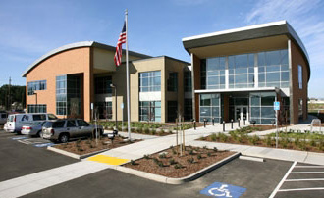
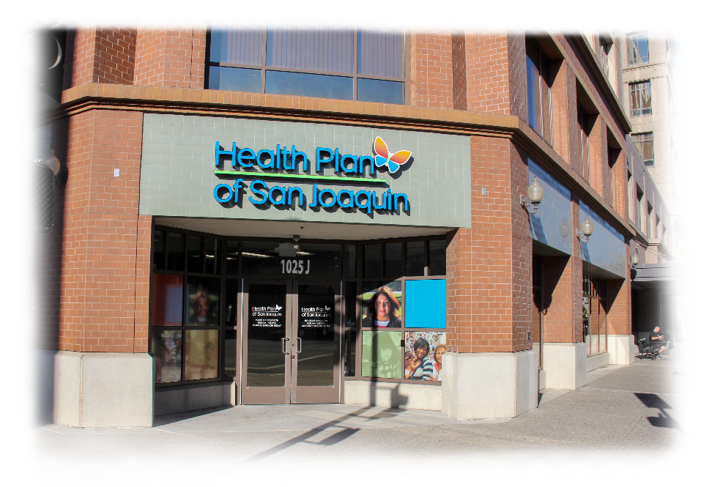
HPSJ OVERVIEW
Established in 1995 by State statute and County ordinance
Coverage in San Joaquin and Stanislaus Counties
Serving over 345,000 members: Medi-Cal and TPA
Employer of choice with nearly 300 employees
40,000+ square foot Headquarters in French Camp
Expanded office in Stanislaus County-- Downtown Modesto

Slide 4

MISSION DRIVEN AND COMMUNITY FOCUSED

Slide 5
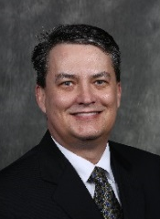

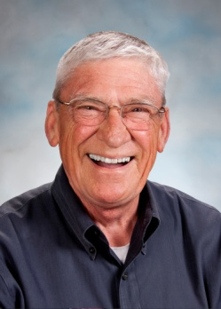
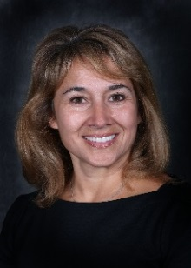
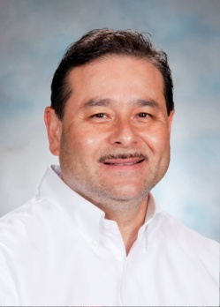
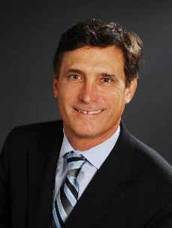
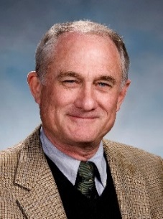
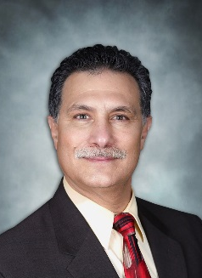
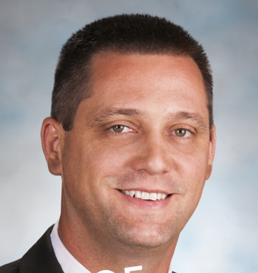
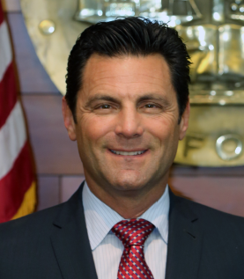

LOCALLY BASED, LOCALLY GOVERNED
SAN JOAQUIN COUNTY HEALTH COMMISSION
11 Member Commission
Greg Diederich (Chair), Director of SJC Healthcare Services
Michael Herrera, DO, local physician
George Khoury, MD, local physician
Sheela Kapre, MD, local physician
John Zeiter, MD, local physician
Brian Jensen, Hospital Council Cen/Nor CA
Mike Kirkpatrick, community representative
Larry Ruhstaller, community representative
Miguel Villapudua, SJC Supervisor
Tom Patti, SJC Supervisor
Monica Nino, SJC Administrator

Slide 6
MEDICAID
Medi-Cal: California’s Medicaid Program
  Medi-Cal - largest Medicaid program in the U.S., established in 1973
  Covers over 30% of all Californians, and more than 50% of CA children
    14.3 million projected in 2017-18
  2016-17 Medi-Cal budget of $100 billion (total funds)
Medi-Cal Delivery
Managed Care Transition & Expansion
Managed Care Today
2013 – Healthy Families Program
2014 – Mandatory and Optional ACA Expansions
Over 10 million enrolled in managed care
Now in all 58 counties
Model varies by county
2010/11 – Seniors and Persons with Disabilities
Geographic Managed Care (GMC)
2013 – Rural Counties Expansion
2015 – Pregnant Women 138 FPL
2016 – Undocumented Children
Two-Plan Model
County Organized Health System (COHS)

Slide 7
MEDI-CAL MANAGED CARE PLAN
HPSJ serves as the Local Initiative in San Joaquin and Stanislaus Counties.
Two-Plan Model
Medi-Cal
Managed Care
Two-Plan Model
Local Initiative: HPSJ
Local Initiative (LI) competes with Commercial Plan (CP)
Local Initiative is locally developed, county sponsored, and accountable to the public
Newest (1993) and most commonly used model
Allows choice and public engagement
5.7 million enrollees in 14 counties
LIs cover 71% of two-plan market
10 LI plans
Source: DHCS 11/2014

Slide 8
Medicaid Expansion under the Affordable Care Act

Slide 9
CA’s Implementation of the ACA
ACA was signed into law in 2010, largely taking effect in 2014
  New consumer protections
  Financial assistance for 90% of Californians’ using Covered California
  Medi-Cal expanded to childless adults and parents under 138% of the federal poverty level (FPL)
  Uninsured rate cut in half in CA
ACA by the numbers
  1.4 million Californians’ have a policy through Covered California
  3.8 million Californians’ are in expanded Medi-Cal
  3 million Californians’ remain uninsured (large portion are undocumented adults)
San Joaquin County
  Uninsured rate reduced from 17.2% to 7.7%.

Slide 10
Medicaid Expansion
$33,948/year
Gross Income
Family of 4
$16,643/year
Gross Income
Single Adult

Slide 11
ACA Today in CA and San Joaquin County
Covered California –
  More than 1.4 million people bought insurance through Covered CA (in 2016)
  90% of all Covered CA enrollees receive tax credits to lower premiums
    The average subsidy pays for 77% of the monthly premiums
    Subsidy levels rise as premiums rise
    Tax credit/subsidies amount to nearly $5 billion in federal funding
  11 health insurers offer coverage options
  22,150 individuals in San Joaquin County currently get subsidies in Covered CA
Medi-Cal –
  Serves more than 14 million low-income Californians, including children, working parents, seniors, and others (nearly 1/3 of California’s population).
  41% of San Joaquin County is on Medi-Cal
  73,773 individuals in San Joaquin County enrolled in Medi-Cal through the expansion (incomes up to 138% FPL for families and childless adults – pre-ACA only families up to 100% FPL)
  Nearly 50% of all births in CA are financed by Medi-Cal
  6 out of 10 children are on Medi-Cal
  Total Budget = $90.3 billion (in 2016)

Slide 12
Local Growth in Medi-Cal Coverage
HPSJ’s Medi-Cal Expansion Membership (Jan 2017)
San Joaquin 52,813
Stanislaus 35,643
Total 88,456

Slide 13
Source of Care
Prior to ACA
Indigent Care through Counties (income under 200% of FPL)
Disconnected from preventive services or the health care system
Individuals would go without care leading to preventable hospitalizations and/or chronic conditions
Episodic Care in Hospital Emergency Departments, crisis mental health services, or in jail.

Slide 14
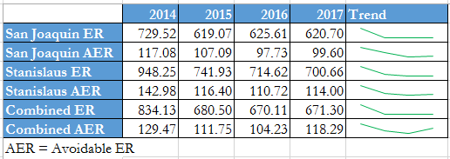
Emergency Room Trends
Increase in ER utilization in 2014 due to ACA mbrs
Prospective Intervention – New Mbr Outreach & Materials (PCP, available services)
Retrospective Intervention – Call mbrs with ≥ER visits (PCP, HealthReach, UC)

Slide 15
Healthcare Access
CA 1/3 on MCL
In SJ Valley 44% on MCL
MCL access is ever more important for HC services
¾ of MCL mbrs had a usual source of care (PCP/clinic)
MCL mbrs are 33% more likely to receive routine check-ups when compared to uninsured
Minus MCL expansion burden shifts back to individuals and local agencies.

Slide 16
Federal Efforts to Repeal and Replace the ACA

Slide 17
Bills in the House and Senate
Current law | House bill - AHCA | Senate bill - BCRA
MEDICAID FUNDING: • Open-ended, federal-state match • CA FMAP is 50% | • Per capita cap (PCC) for most beneficiaries (FY 2020) • Block grant funding option • States could institute work requirements for adults (FY 2018) | • PCC for beneficiaries in same groups (FY 2020) • Block grant option • Optional work requirements
MEDICAID EXPANSION: • ACA provided enhanced FMAP for expansion adults • Started at 100% • 95% today • Phases down to 90% by 2020 | • Enhanced FMAP continued until 2020 • FMAP drops to traditional FMAP in 2020 • 50% in CA • Enhanced FMAP for grandfathered enrollees • Requires 6-month redetermination | • Enhanced FMAP continues until 2021 • Phases down enhanced FMAP to: • 85% in 2021 • 80% in 2022 • 75% in 2023 • traditional FMAP in 2024 (50% in CA) • No provisions on grandfathered enrollees • Requires 6-month redetermination

Slide 18
ACA Repeal by the Numbers
American Health Care Act (AHCA) passed by the house on May 4
Congressional Budget Office (CBO):
  23 Million would lose coverage
    14 Million would lose Medicaid
  $834 Billion reduction to Medicaid (Medi-Cal)
  $664 Billion reduction in taxes
Better Care Reconciliation Act (BCRA) discussion draft released by the Senate on June 22 and updated on June 26
CBO:
  22 Million would lose coverage
    15 Million would lose Medicaid
  $772 Billion reduction to Medicaid (Medi-Cal)
  $541 Billion reduction in taxes

Slide 19
Repeal without Replace in CA
5 million people in California would lose health insurance. This would cause families to go without needed health care and expose them to ﬁnancial risk.
  95,923 people in San Joaquin County would lose health coverage (Covered CA and Medi-Cal)
California would lose $20 billion in federal funding for Medi-Cal and Covered California
Elimination of the Medi-Cal expansion, and 3.8 million people losing that coverage.
California would lose 209,000 jobs with an ACA repeal
  4,000 jobs lost and $324 million lost in GDP for San Joaquin County

Slide 20
Impact to California
Top Two Cost Concerns in Repeal/Replace Proposals
Per Capita Caps (Medicaid Reform)
Medicaid Expansion Phase-Down
 | Cost to California (DHCS Fiscal Analysis)
AHCA | 2020 - Nearly $6 billion ($4.3 billion GF) 2027 - $24.3 billion ($18.6 billion GF).
BCRA | 2020 - Nearly $3 billion ($3.0 billion GF) 2027 - $30.3 billion ($24.3 billion GF).

Slide 21
Economic Impacts

