Slide 1




Health in All Policies: A state-level approach to improving community health
Lianne Dillon, MPH
July 18th 2017, San Joaquin Council of Governments
Healthy Communities Seminar

Slide 2
Overview
What is a healthy community?
State-level efforts
The Health in All Policies approach
CA Climate Investments
CDPH Climate Change & Health Equity Program
Notes:
Talk to you today from a state level perspective about the connections btwn health, climate change, and equity
HiAP is an approach to government decision making focused on collaboration across sectors and ensuring health, equity, and env sustainability are cornerstones of government decisions
What if the transportation

Slide 3
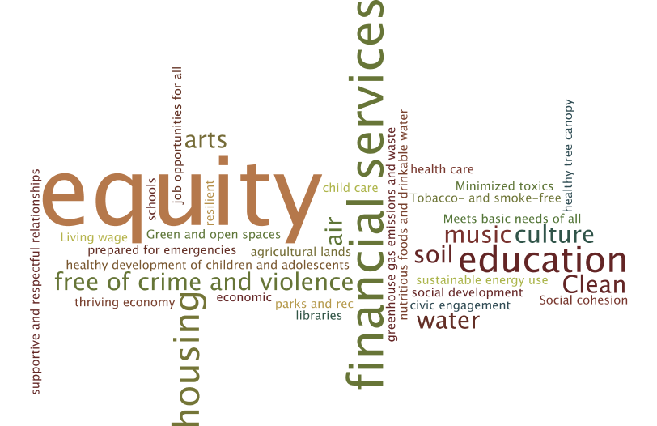
What is a Healthy Community?
Safe
High Quality
Accessible
Sustainable
Affordable
Notes:
What is a healthy community?
Which of these things does public health have purview over?
Who has access? Who is benefitting?

Slide 4
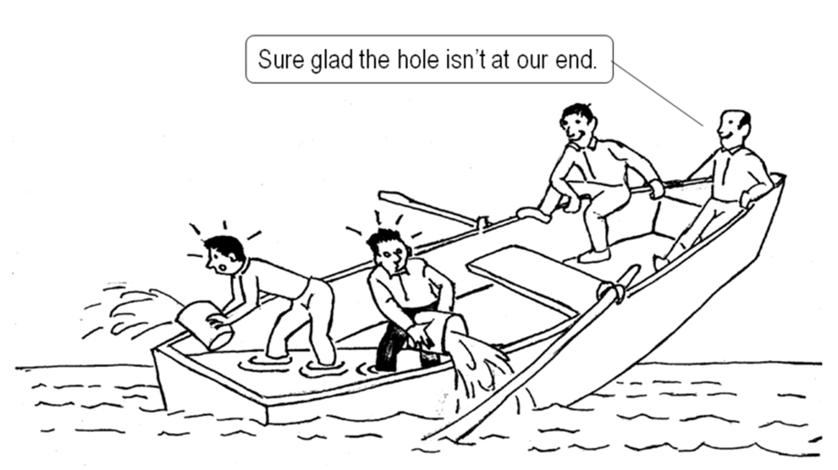
What do you notice?
Notes:
Key message – collaboration, we are all in this together
Poverty, homelessness, displacement, climate change, health care
What does this make you think of in your work?
Do you see any connections to healthy communities?
Does this have anything to do with equity? Climate change? Poverty?
Someone gave them those buckets, what if someone would have given them life jackets? Or a new boat? Or sent a repair crew to fix the boat?
Blissful ignorance, they are smiling!
Were the bailers the same folks actually rowing the boat? So now they aren’t even going anywhere

Slide 5
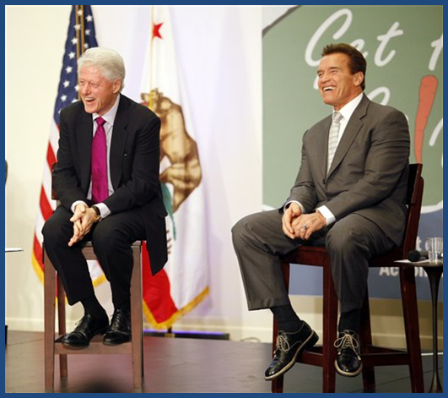
Establishing CA’s HiAP Task Force
Governor Executive Order
Response to Climate Change and Childhood Obesity concerns
Notes:
This is where the HiAP approach comes in!
Governments internationally have been using it to address these complex issues that no one single gov entity on their own can solve.
What is HiAP?
A collaborative approach to improving the well-being of all people by incorporating health, equity, and sustainability considerations into decision-making across sectors and policy areas.
Here in CA gov established because of nexus btwn health and climate change.
Recognize that collaboration does not just happen!!! Need staff and resources and a forum

Slide 6






















California Health in All Policies Task Force
Created in 2010 by Governor’s Executive Order
Accountable to Strategic Growth Council
Mandate – collaboration to advance health, equity, & sustainability

Slide 7
Purpose of the HiAP Task Force (what we do)
Promote a government culture that prioritizes the health and equity of all Californians across policy areas.
Infuse state agency and department practices with health and equity considerations.
Provide a forum for departments and agencies to identify shared goals and opportunities to enhance performance through collaboration.
Notes:
This is TRANSFORMATIVE WORK.
Take what government is already doing, and make it better.
Doesn’t need new programs or lots of new money.
This is about overlaying PH values over everything.
It’s a culture shift.
Hard to measure but amazingly rewarding.

Slide 8

Taking Action to Advance Healthy Communities
Parks, Green Space, and Healthy Tree Canopy
Active Transportation - Land Use, Schools, and Health Work Group
Equity in Government Practices
Notes:
What does IMPLEMENTATION look like?

Slide 9
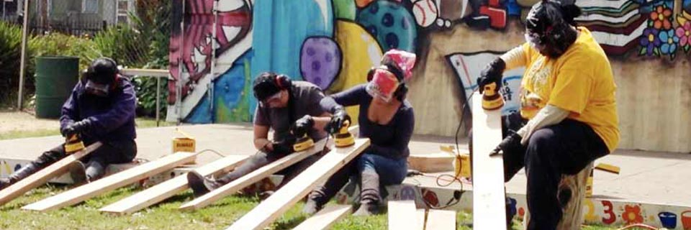
Parks, Green Space, and Healthy Tree Canopy
Draft goal: Priority communities benefit from optimized access to tree canopy, open space, and parks as well as maintenance of these essential community spaces as a result of increased state agency and department collaboration.
Pogo Park, City of Richmond, CA
Notes:
Air quality benefits, heat island
Inequitable distribution of the benefits of parks and tree canopy

Slide 10
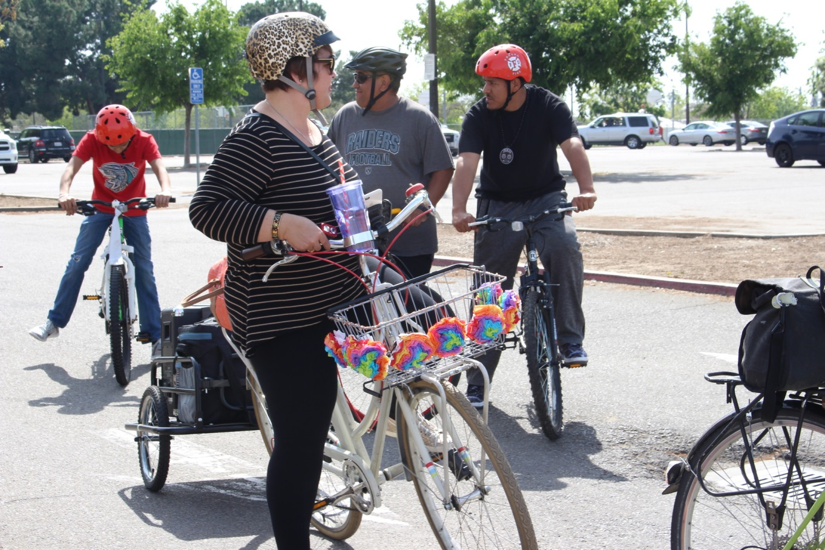
Active Transportation
Draft Goal: By 2020, increase non-auto modes of transportation: triple bicycle; double pedestrian, double transit modes, as measured by the California Household Travel Survey.
Genoveva Islas of Cultiva La Salud prepares to lead a “Cumbia Ride” in Fresno, CA.
Notes:
In 2017, the Task Force will be developing a new action plan will focused on Active Transportation. This will be a continuation of work that is already quite strong.
The Task Force is interested in organizing the action plan to support the state dept. of transportation’s (Caltrans) goal to “triple biking and double ped and transit use by 2020.” This is an excellent example of a measurable goal that promotes health and reduces greenhouse gas emissions.
Caltrans also has a goal to reach zero bike/ped fatalities in the State. We all know that the communities that have the greatest numbers of cyclists, pedestrians, and transit riders, and that face the highest rates of death/injury tend to be low-income communities and communities of color. So this is actually an equity goal as well as a health goal.
We want to encourage things like what’s happening in this photo -
This is a picture of our friend Genoveva Islas, leading the Fresno “Cumbia Bike Ride”
The Cumbia Ride is an organized community bike ride that allows residents to have a safe biking opportunity with friends and family while listening to Cumbia music. They also raise awareness of the need for improved biking infrastructure in Orange Cove and Southeast Fresno.
It’s really important that we not only increase bike and ped infrastructure, but also that we support non-infrastructure projects to promote safety and education for drivers and people who are walking and biking.

Slide 11
Equity in Government Practices
Draft goal: Increase use of equity metrics, criteria, tools, and strategies
“We are committed to advancing equity throughout all of its programs, and welcome the opportunity to partner with HiAP or other state agencies to continue to broaden our equity focus.”
“Establishing a vision or guiding principle for equity that applies across our department’s diverse divisions would likely be a valuable component of our engagement on equity issues.”
“Intentional and replicable collaboration around initiatives like HiAP will help staff to think about how we apply an equity lens to our work.”
Notes:
The third topic that the Task Force has chosen for a new Action Plan is Equity in Government Practices.
Nearly every agency and department is promoting equity in some way, and most have been doing this for decades.
California government is deeply committed to promoting fair and inclusionary policies and practices.
You all in this room are part of that.
Through the HiAP Task Force, we already provide quarterly learning forums, where agencies and departments share their equity practices, opportunities, and challenges, with each other.
Later this week, we will distribute a questionnaire to government agencies and departments to learn what you all are already doing around equity, what barriers you face, and what you think the HiAP Task Force can do to help. That will guide the development of the Action Plan.
Specific actions will likely include commitments by individual agencies and departments to enhance health and equity considerations in

Slide 12
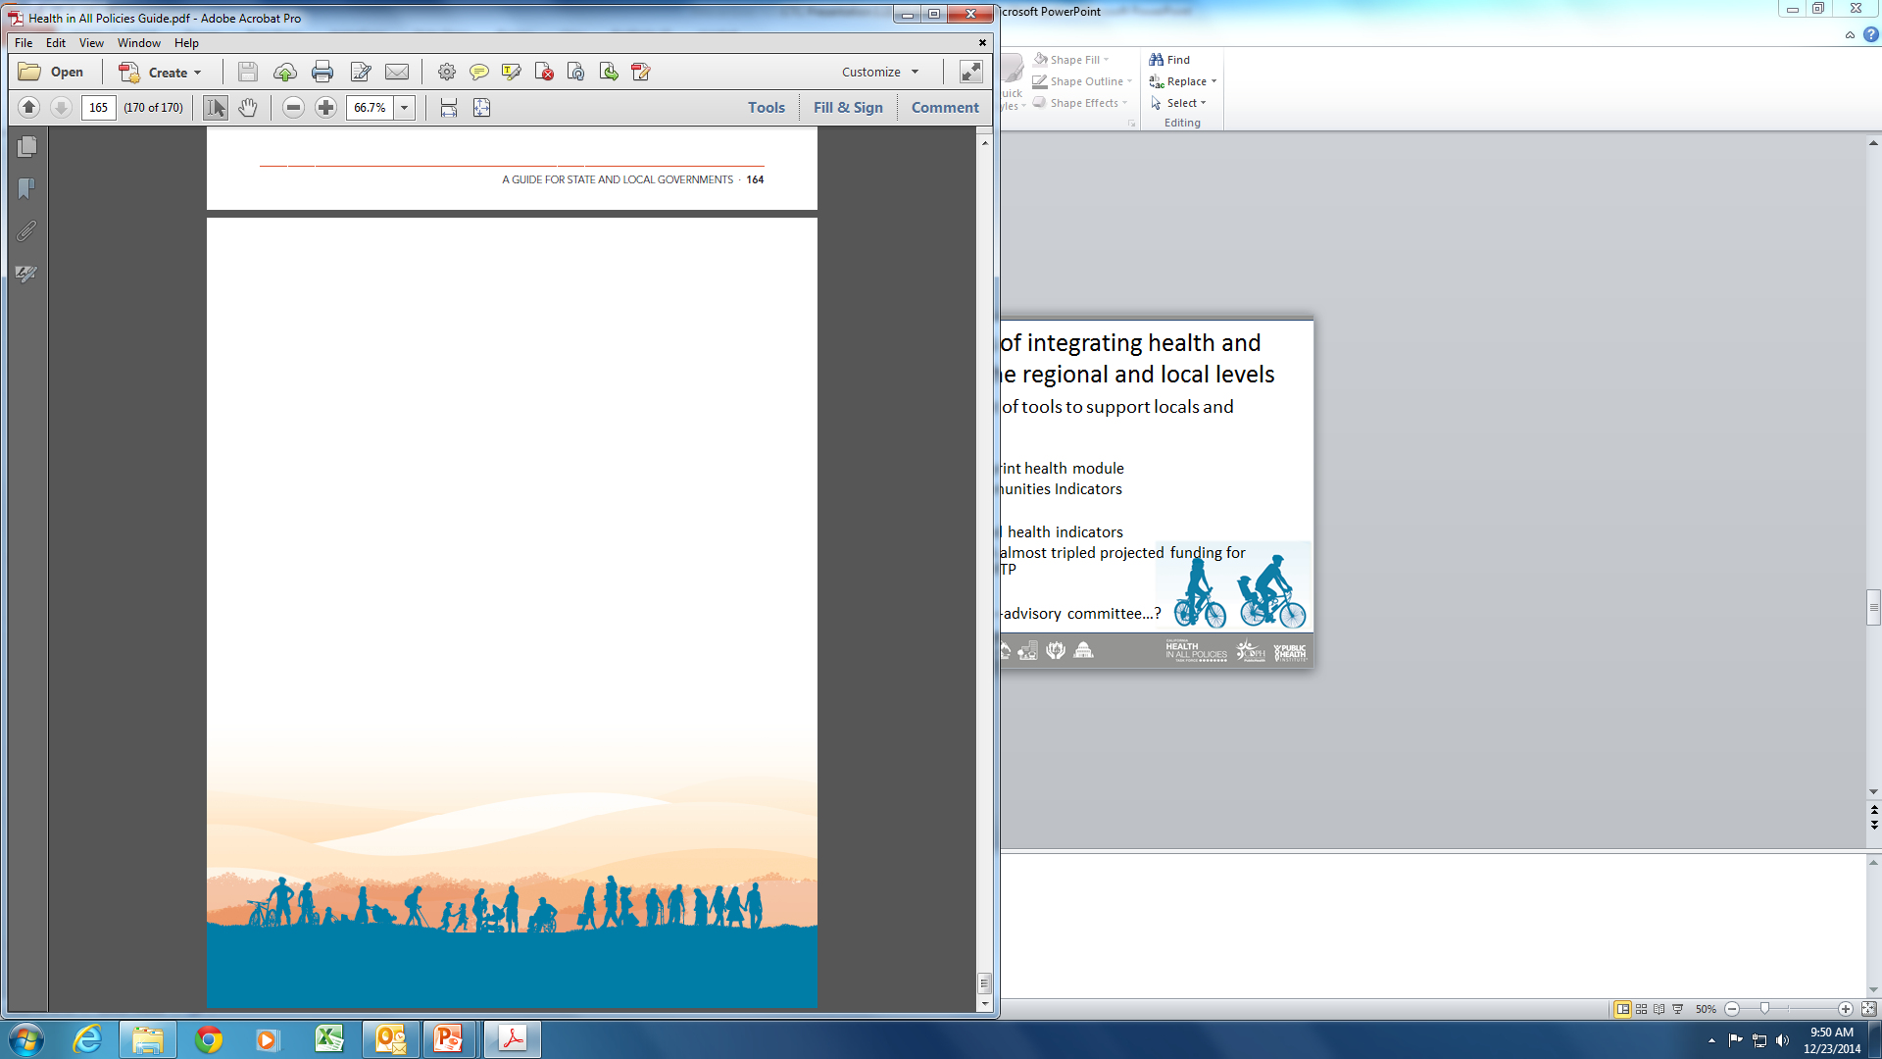
Building Health in All Policies Partnerships
Pursue mutuality and practice generosity.
Acknowledge what you don’t know.
Understand your partners’ goals and context.
Identify co-benefits.
Collaboration takes time.
Notes:
III. Implementation of partnerships – what and who at different levels
a. Learn the language
b. Don’t assume they know what you do
c. How to get started, who to work with
IV. What’s next and what are the take aways? What do we want them to do, where should they take the lead?
We often ask our partners:
What are your priorities?
How can we help?
What are areas of alignment?
Approach differences of opinion with curiosity, and treat them as opportunities to learn.
Ask your partners about their goals and priorities, and pay attention to the political and organizational context in which they work. This can include past interagency interactions, successes and failures, or other issues that may shape perspectives.
Intersectoral collaboration works best when all partners can see tangible gains for themselves. Potential partners may ask themselves, “What’s in it for me or my organization?” Identifying win-win opportunities helps establish buy-in, allows partners to leverage resources, and increases efficiency by pursing multiple goals.

Slide 13
Health in All Policies across the US
North Carolina
Del Norte County, CA
Ventura County, CA
St Petersburg, Florida
Vermont
Tulare County, CA
Lane County, Oregon
Bernalillo County, NM
North Dakota
Chicago, IL
Merced County, CA
Monterey County, CA
City of Richmond, CA
Notes:
Getting started:
Riverside & Monterey – embedded in ph strategic planning. Any time your govt is doing a planning process, PH can step up and pitch this HiAP approach as a whole-of-government way of considering health, eq, and sust and building collaborative partnerships.
Implementation:
Richmond & Monterey – through general plan
Tulare County: Providing HiAP training to leaders in unincorporated communities prior to community planning discussions
Monterey County: Realignment funds used o develop (PEP) to work on health equity, accreditation, and cross bureau collaboration.
Del Norte County: Adopted city-level HiAP Resolution. Includes HLA of city’s General Plan and development of city-wide Employee Wellness Policy
Tulare; (a process started by planning department to ensure that community plans align with the approved county General Plan)
Monterrey: We have the support and encouragement from management to go build relationships with other sectors. Example: lunch

Slide 14

California Climate Investments
Transformational Climate Communities
Reduce GHG’s
Improve Public Health
Expand Economic Opportunity
Investing in most overburdened
Addressing environmental, socioeconomic, and health inequities
Funds planning and projects
Affordable Housing Sustainable Communities
Reduce GHG’s
implement land-use, housing, transportation, and agricultural land preservation
support infill and compact development
Urban Greening
Urban Forestry
Notes:
AHSC
really trying to reduce vehicle miles traveled and build ridership for transportation systems by locating housing near transportation and ensuring that the two are connected.
want folks to have choices in how they get around other than using their car.
We are creating more walkable/bikeable communities by paying for a whooollleee bunch of sidewalk and bikelanes.
And we can pay for programs like bike safety, school walking, etc etc!
Also we are preserving affordability as we improve transportation and connectivity, and doing our best to make sure we consider all of the displacement concerns that come with these kinds of improvements.
TCC is focused on investing in the communities in our state that are the most overburdened by environmental, socioeconomic and health inequities.
Applicants must address three Program Objectives:
​1. Reduce GHG's
2. Improve Public Health and Environmental Benefits
3. Expand Economic Opportunity and Shared Prosperity (workforce training, local business expansion, etc.)
​

Slide 15
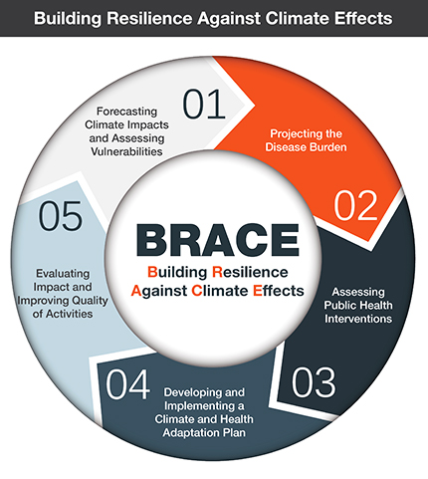
California Building Resilience Against Climate Effects (CalBRACE) Project
Goals
Prepare CA for climate change adaptation and reduce the risk of adverse health consequences of climate change
Elevate the role of health and equity in state, regional, and local climate change adaptation planning
Identify climate change adaptation strategies that have health equity co-benefits
Be an ongoing resource for stakeholders throughout the state
Notes:
The CDPH Office of Health Equity is one of 16 states and 2 cities funded by the CDC’s Climate Ready States and Cities Initiative.
-a five-step process that helps health officials develop strategies and programs to help communities prepare for the health effects of climate change.
-CalBRACE seeks to enhance communities’ capability to plan for and reduce health risks associated with climate change.

Slide 16
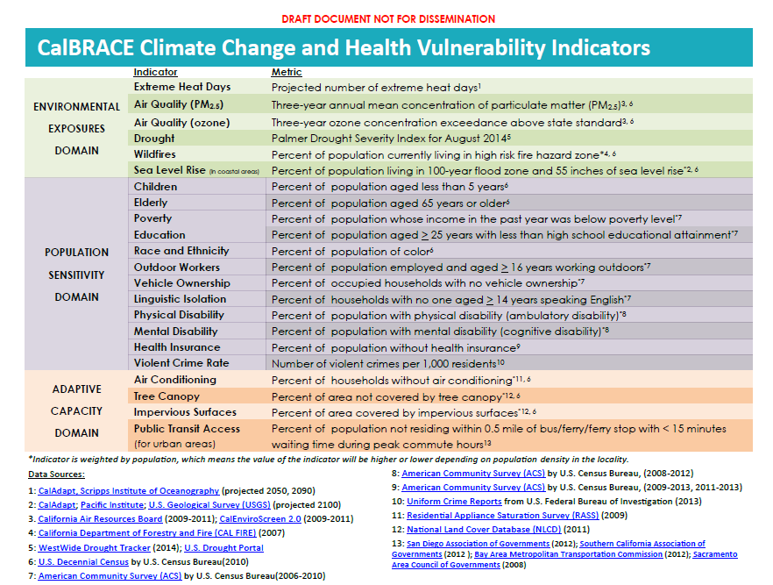
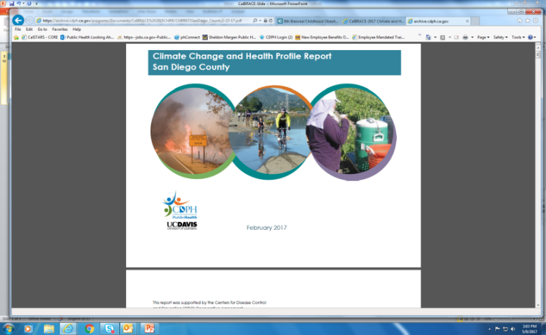
CalBRACE Resources: Climate Change and Health Vulnerability Indicators Climate Change and Health Profiles Reports
Local data and reports to assess climate impacts, related health outcomes, and vulnerable populations.
Notes:
The CalBRACE Project recently released Climate Change and Health Profile reports for every county in California and a suite of indicators for developing climate vulnerability assessments for each county in California.
The indicator data for each of the variables listed in this chart are available on the CalBRACE website in excel files. The data go down to the Census Tract level for many indicators, and the county level for those that aren’t available at Census Tract. Information to guide use of the data is also included in the accompanying data narratives, and you can always contact CalBRACE staff for more information.
The Climate Change and Health Profile reports present an overview of climate science and link current and projected climate change risks to health outcomes. They summarize the data in the indicators for each county in California, including local statistics and maps. The data in these reports can be used to educate stakeholders. In fact, CalBRACE will soon release a sample powerpoint presentation that communities can insert their data into and use to provide information to stakeholders on the importance of climate change and its impact on health, including local data.
The next few slides will provide examples of this from the San Joaquin County health profiles report.

Slide 17
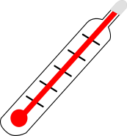



Climate Projections: Northern Central Valley
12-15 °F
July temp (2100)
⬇ 4 – 5 inches
Annual rainfall (2090)
5-8/yr
Heat waves (2100)
Source: California Adaptation Planning Guide
Notes:
For example, the reports include climate projections for the climate region that San Joaquin County is part of – the Northern Central Valley region. Overall, we expect July temperatures to increase by 12-15 degrees F by 2100, rainfall to decrease by 4-5 inches by 2090, and the number of heat waves per year to increase by 5-8 additional heat waves by 2100. This is an example of both the data included in the report, as well as one of the slides that will be shared and can be adapted for local use.

Slide 18
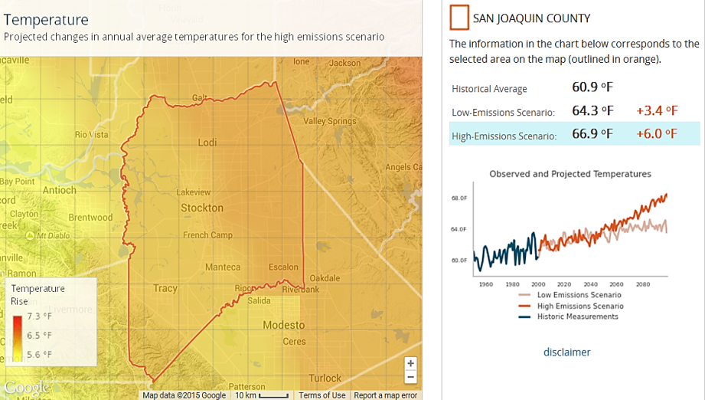
Projected Annual Average Temperature San Joaquin County, 2099
Source: CalAdapt
Notes:
This is an example of heat information included in the reports. This map shows that the projected temperature in SJ County will increase by 3.4°F by 2099 under a low emissions scenario, which is a scenario where we reduce emissions greatly. In a high emissions scenario, where we continue with business as usual without reducing fossil fuels, we may see up to 6°F here in the county.

Slide 19





Vulnerabilities in San Joaquin County Households Most at Risk
45% of low-income residents have unreliable access to sufficient, affordable, nutritious food.
20% of adults have been diagnosed with asthma
27,180 residents are outdoor workers
23% of adults (>25 years) have less than high school education
10% of households are without English proficiency
Source:
CalBRACE Vulnerability Assessment Report, CDPH; CalBRACE Climate Change and Health Profile Report, CDPH
Notes:
These are examples of data on vulnerable populations in the county, which can also be found in the reports. (Can read some examples).
From the indicator data on the CalBRACE website, you can also find whether the rate of any of the indicators is above or below the state average, rates for some of the indicators separated out by race/ethnicity, data for smaller geographic areas (in most cases), and more.

Slide 20
Why Government?
“Democratic government is… one of the greatest institutional inventions of modern Western civilization. It allows us to pool our resources and to act collectively to address the serious social, economic, and environmental problems that we are unable to deal with as individuals. What’s more, government serves as an essential instrument of moral action – a way for us to rectify injustices, eliminate suffering, and care for each other.”
- Government is Good, by Douglas J. Amy, 2011
Notes:
Ask someone to read quote. My takeaway from this quote is that we get to be visionary and think big.
And I want to mention that there are a lot of cities and counties and some states doing this work.

Slide 21

Lianne Dillon, HiAP Task Force Staff
Lianne.Dillon@SGC.ca.gov
HiAP Task Force website
http://sgc.ca.gov/s_hiap.php
HiAP mailing list
HiAP@sgc.ca.gov

